Slide 1
Rebuilding the SGV Economy 2021
Bob Machuca
March 11th, 2021
POWERED BY

Slide 2
Field Observations – SGV Business Base
Prior to Covid
Covid- March 19th 2020 to Present
Programs to assist Businesses
Opportunities in the SGV- Rebuilding
2019

Slide 4
Los Angeles County/ San Gabriel Valley Connections to Resources
Permit Assistance
City Permits
LA County Public Works
Financing
County Loans
Business & Expansion
Technology
Float Loans
LA County Public Health Dept
Small Business
Development
Centers
SBA
7A
504
Micro
EIDL/PPP
LA County Building & Safety
LA County Fire & Sanitation
Energy Efficiencies
Southern California Edison (SCE)
Southern California Gas Co.
Workforce
America’s Job Centers of CA
Employee Training Funding
Recruitment- Screening
OJT/TSE/ETP
LADWP
Internships
Business Technical Assistance
Workshare/ UI Benefits
Layoff Transition
Municipal Programs
Reduce Risk/ Increase Bottom Line
Risk Management/ Employee Benefits Workers Comp
Cost Segregation
CMTC
Lean Manufacturing
Economic Data
Industry Specific Data
Economic Forecasts & Demographics
Real Estate Site Searches

Slide 5
San Gabriel Valley Economic Partnership
Business Assistance Program
Annie Wei/ Amy Foell
Business One-on-One Consulting
Business Walks
Economic/ Labor Data
Workforce Development
019

Slide 6
Top Challenges Faced By Businesses
Prior to Covid
Growing revenue
Hiring and finding qualified employees
Cash flow management
Cost containment
Access to capital
Technology
Marketing strategy
Time management
Employee healthcare
Government regulation and compliance
2019

Slide 7
Top Challenges Faced By Non-Essential Businesses
March 19, 2020
Businesses Closed Temporarily/ Permanently / Restrictions
Access to Capital, Funding, Emergency Cash-Flow
Lost Revenues; 30%, 50%, 70%, 90%
Lay-offs, Downsizing
Employees Infected with Covid/ Spread in Workplace
Fear of New-Hires
Mixed Signals/ County-State-Fed
Uncertainty
2019

Slide 8
www.laedc.org/coronavirus

Slide 9
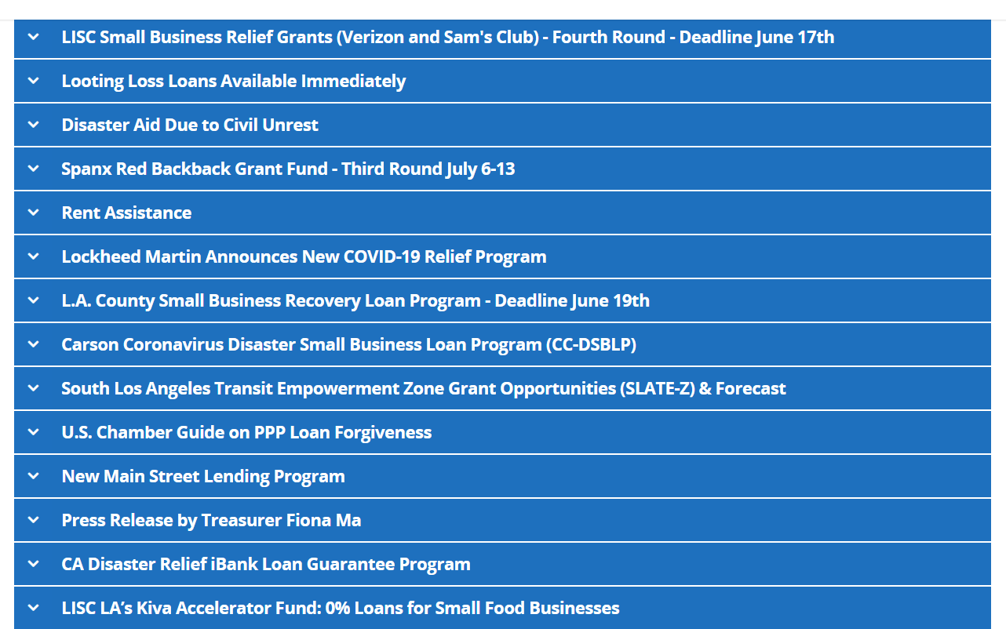
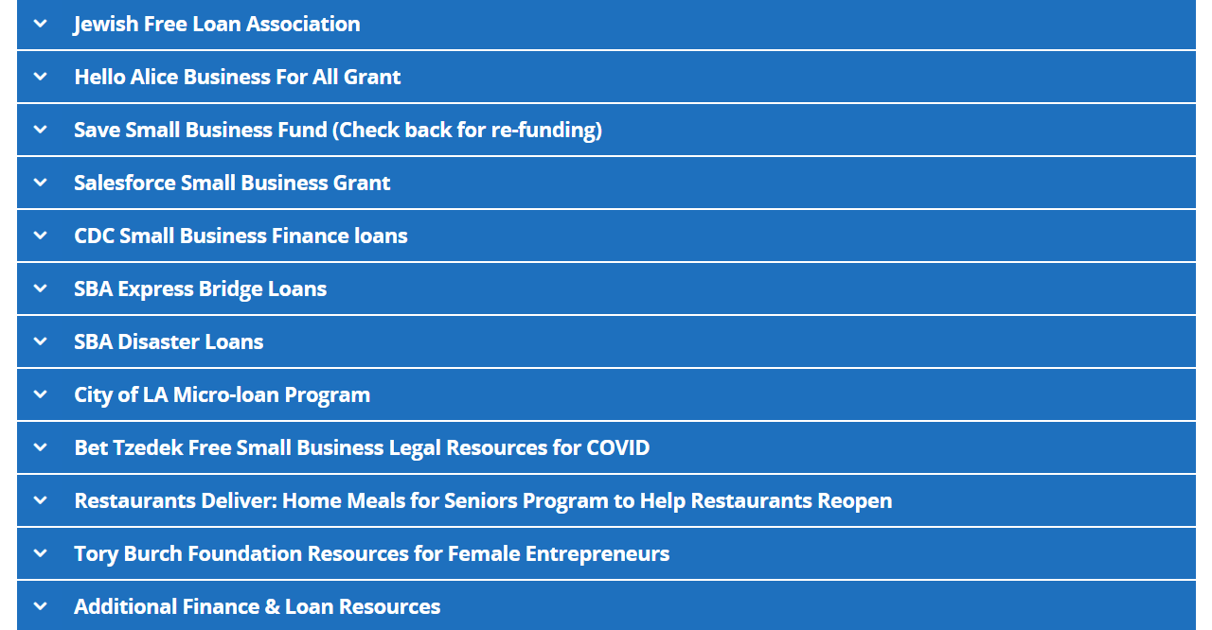
www.laedc.org/coronavirus
Emergency Relief/Grants & Loans

Slide 10
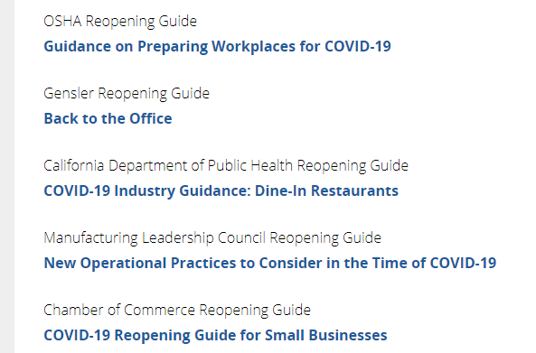
www.laedc.org/coronavirus
Reopening Strategies

Slide 11
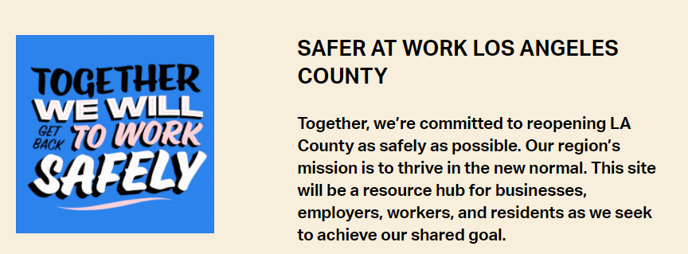
Safer At Work
Resources designed to help businesses across the County communicate to their employees and customers the critical steps they are taking in order to operate as safely as possible during the COVID-19 pandemic.
Collateral, posters, and digital graphics for use in your business, on your website, and across social media channels.
https://www.saferatwork.la/

Slide 12
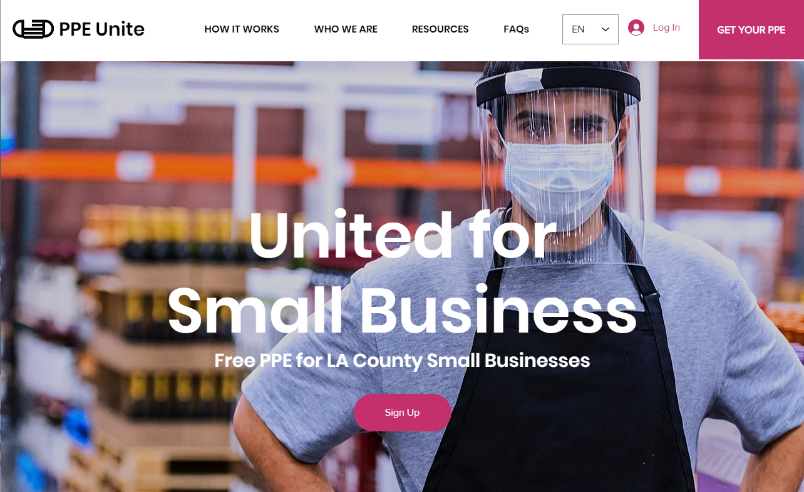
PPE Unite – free PPE for small businesses
https://www.ppeunite.org/
The PPE Unite™ program distributes valuable face masks, hand sanitizer, and face shields to eligible small businesses in the County of Los Angeles. Sign up is simple and it is easy to schedule a pickup. Certain rules and eligibility requirements apply.
Free PPE for small business located within L.A. County with less than 100 employees.
One-time 30-day supply of PPE
Safe contactless pickup with easy scheduling of your own confirmed appointment time slot.
PPE amount may vary depending on business profile.

Slide 13
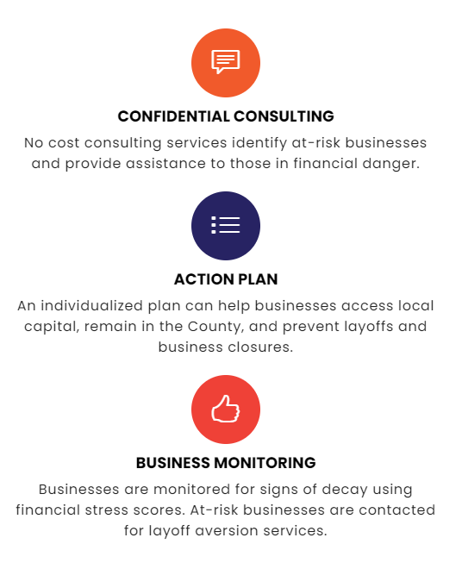
Layoff Aversion and Subsidized Wages
Avoid future layoffs, access incumbent worker training programs and skilled job seekers, and become familiar with employment rights and regulations.
Layoff aversion consists of strategies and activities to prevent or minimize the duration of unemployment resulting from layoffs.
Rapid Response is a pro-active approach to quickly maximize public and private resources to minimize the disruptions that are associated with job losses on your business, your workers, and the communities in which you do business and live.
Find you closest America’s Job Center of California (AJCC) https://workforce.lacounty.gov/

Slide 14
Economic Recovery Programs
Small Business Stabilization Loan Program
SBA PPP 2 Round/ now through March 31st
Economic Injury Disaster Loan (EIDL)
Grants - California Small Business/ Various
E-Bay E-commerce training
Webinars for Manufacturers- CMTC
Free Personal Protection Equipment (PPE)
Become a Vendor for Los Angeles County
Workforce On-the-Job training/ Incumbent Workers
PROPRIETARY AND CONFIDENTIAL INFORMATION – NOT FOR PUBLIC DISTRIBUTION

Slide 15
Rebuilding- San Gabriel Valley
Businesses Pivoting/ Innovation/ Resilient
Herd Immunity/ Safe to Return
Pent-up Demand
New Opportunities/ Available Sites- Entrepreneurs
Diversity-Equity-Inclusion/ Workforce
State/Federal Grants
SGV Industry Clusters/ Rich Ecosystem
PROPRIETARY AND CONFIDENTIAL INFORMATION – NOT FOR PUBLIC DISTRIBUTION

Slide 16
Thank you
www.laedc.org/coronavirus
Bob Machuca, bob.machuca@laedc.org, C: (213) 595-5685

