Slide 1
  San Gabriel Valley Council of Governments
  2019 General Assembly
  April 10, 2019

Slide 2
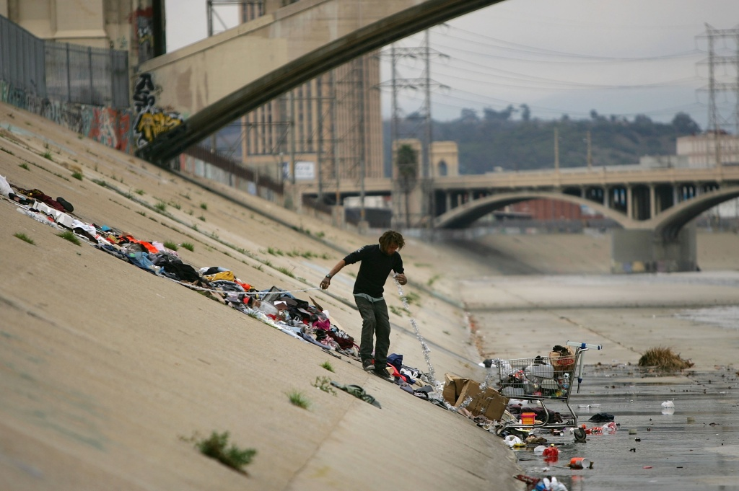
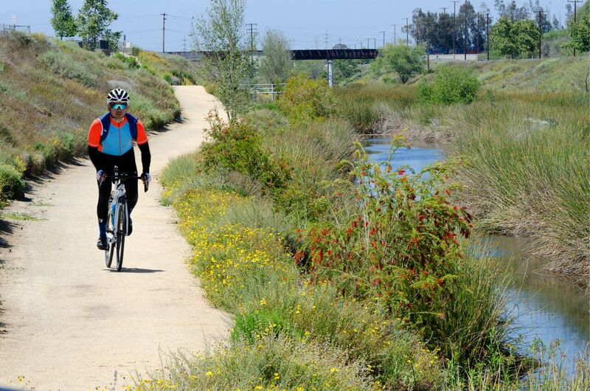
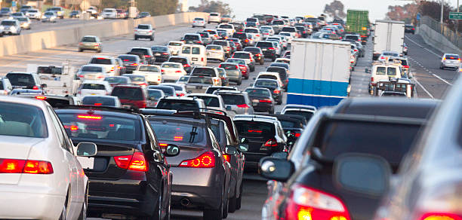
Los Angeles County
  LA County:
  11.5 million by 2025*
* California Department of Finance

Slide 3
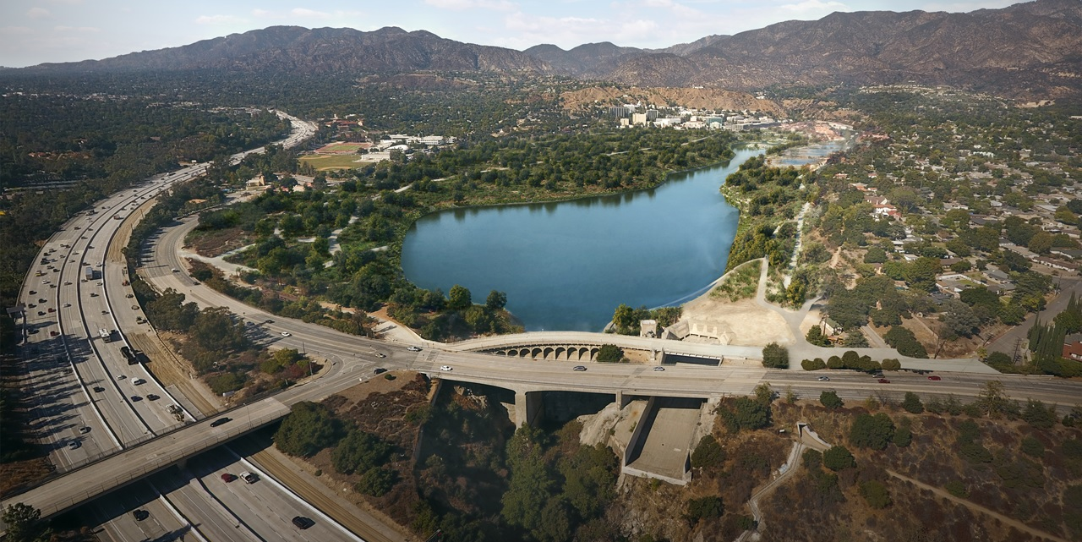
Los Angeles County Public Works
  Six Core Service Areas
  Water Resources
  Development Services
  Transportation
  Environmental Services
  Public Buildings
  Emergency Management

Slide 4
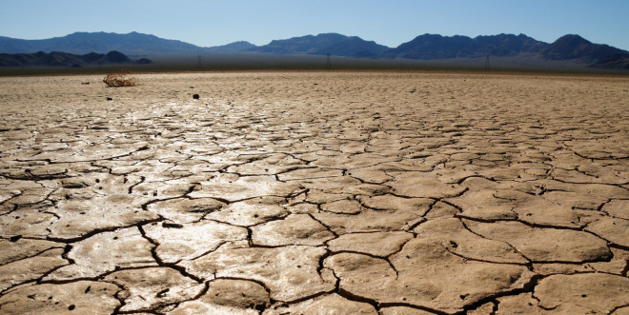
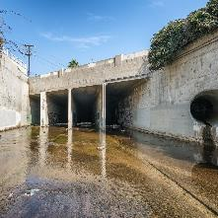
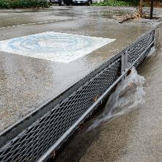
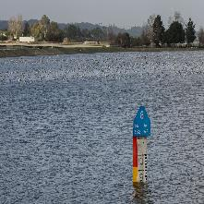
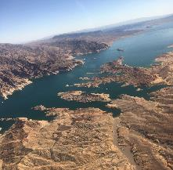
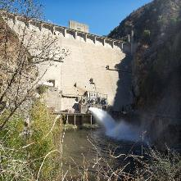
Water Resiliency Challenges
Fractured Jurisdiction
Pollution
Climate Change
Reliance on
Imported Water
Limited Infrastructure
Notes:
Numerous challenges, and will only grow as climate models are predicting more extreme weather cycles.
Stormwater is an underutilized resource and it’s increased utilization could provide opportunity to help establish water resiliency… but of all the water resources available in the region’s portfolio, it lacked a sufficient and dedicated funding source.

Slide 5
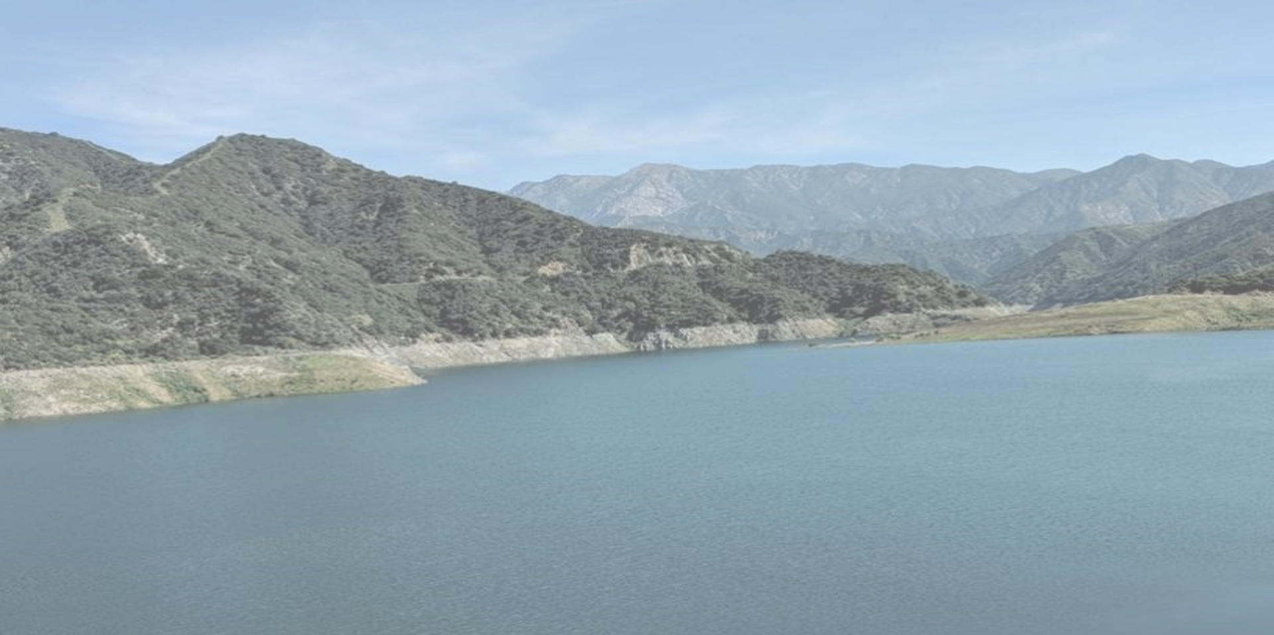
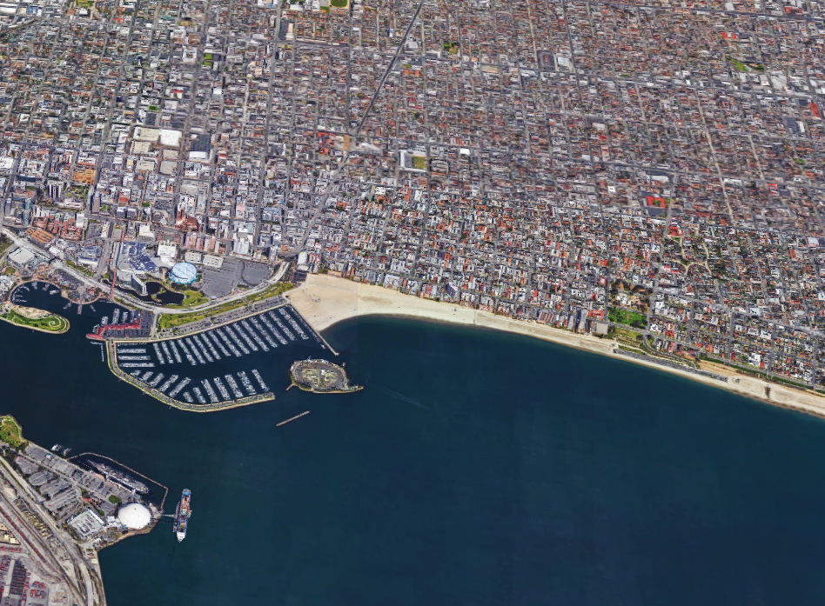
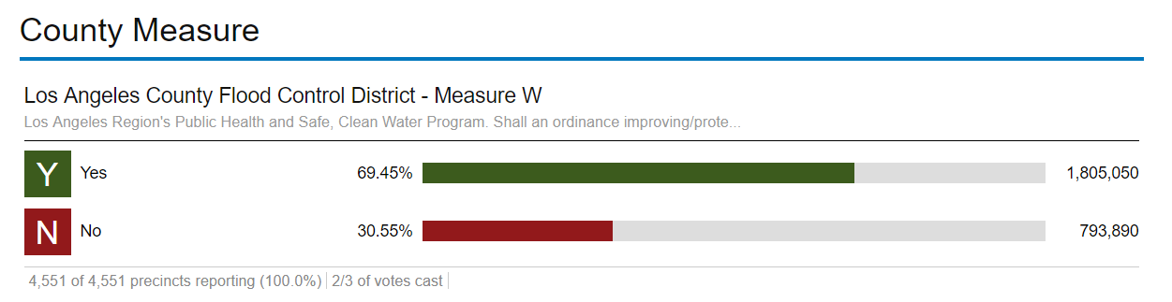



Regional Issue… Regional Approach
CAPTURE
CLEAN
CONSERVE
Improve Water Quality
Increase Local Water Supply
The public agreed …passed with 69.5%. Certified 11/30.
Enhance Communities

Slide 6
Safe, Clean Water Program Fund Allocation
Parcel tax
2.5 cents per square foot of impermeable area
Watershed-based projects
Local & Regional Projects
3 programs to be implemented:
(50% = $150M annually)
(40% = $120M annually)
(10% = $30M annually)
Revised FY19-20 revenue projection available in
summer 2019
Total Program: Approx. $300M annually

Slide 7
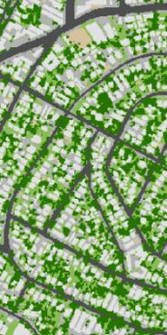
Exemptions, Credits, and Appeals
Exemptions:
Government coded parcel numbers
Parcels already exempt from Ad Valorem taxes
(including qualifying non-profits and other)
Antelope Valley Watershed Area
Low-income senior-owned parcels (under development)
Credits: (under development)
Tax reduction for qualifying stormwater improvements
(SUSMP, IGP, LID, and equivalent)
Up to 100% credit for qualifying additional activities
Appeals: (under development)
If parcel owners feel their tax is wrong, appeals will be available
Web tool being developed to help expedite the appeals process

Slide 8
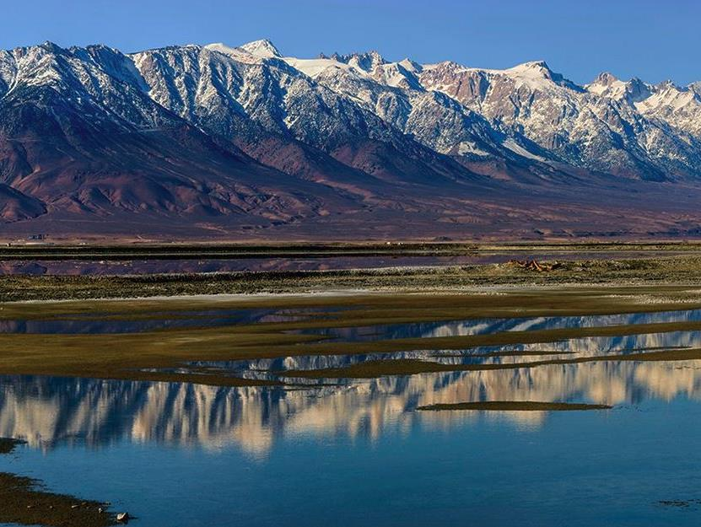
Safe, Clean Water Program
District Program
Features
10% of total
Program revenue
Education programs
Regional Studies
Workforce training
Technical assistance
Administration
Funding provides District-wide regional support and programs.

Slide 9
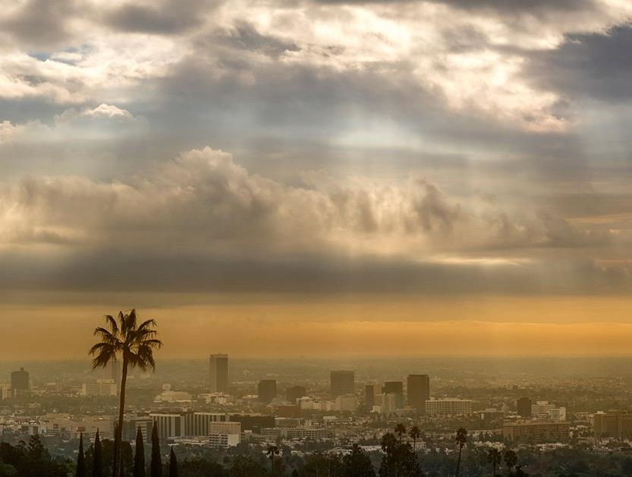
Safe, Clean Water Program
Regional Program
Municipal Program
50% of total
Program revenue
40% of total
Program revenue
Funding returned to each watershed proportional to revenue generated there
Funding returned to each municipality proportional to revenue generated there
Regional infrastructure Multi-benefit projects
Robust stakeholder involvement
Technical assistance
Maximum flexibility for Local Control of funds
Focus on water quality
Funding for existing activities

Slide 10
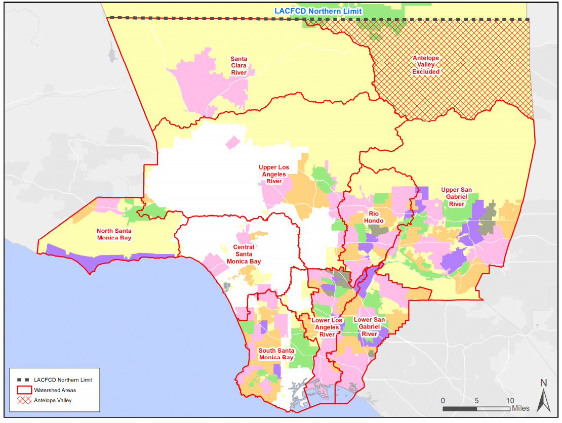
Nine Watershed Areas

Slide 11
Watershed Area Steering Committees (WASCs)
 | Member | Appointed By
1 | Municipality | Varies for Each Watershed Area
2 | Municipality | Varies for Each Watershed Area
3 | Municipality | Varies for Each Watershed Area
4 | Municipality | Varies for Each Watershed Area
5 | Municipality | Varies for Each Watershed Area
6 | Municipality | Varies for Each Watershed Area
7 | Municipality | Varies for Each Watershed Area
8 | District | Appointed by Board of Supervisors
9 | Largest Service Provider- Water Agency | Appointed by Board of Supervisors
10 | Largest Service Provider-Groundwater/Water Agency #2 | Appointed by Board of Supervisors
11 | Largest Service Provider- Sanitation | Appointed by Board of Supervisors
12 | Largest Municipality Agency- Municipal Parks/Open Space/Recreation | Appointed by Board of Supervisors
13 | Business | Appointed by Board of Supervisors
14 | Environmental Justice | Appointed by Board of Supervisors
15 | Environment | Appointed by Board of Supervisors
16 | At large | Appointed by Board of Supervisors
17 | At large | Appointed by Board of Supervisors
 | Watershed Coordinator | Non-voting
Central Santa Monica Bay
Automatic membership if enough Impermeable Area
Municipalities participated in self-selection meetings in January and February
Lower Los Angeles River
Lower San Gabriel River
North Santa Monica Bay
Rio Hondo
Santa Clara River
Agency and community members appointed by the Board of Supervisors
South Santa Monica Bay
Upper Los Angeles River
Upper San Gabriel River
A list of Watershed Coordinators will be provided by the District to the members of the WASC for selection.
Membership Breakdown (17 per WASC)
Municipality 7
Agency 5
Community Stakeholders 5
Notes:
Watershed Area Steering Committees will be formed for each of the 9 Watershed Areas for the purpose of recommending funding allocations for the Regional Program
Municipal seat based on Impermeable Area
Dedicated seats for specific stakeholders
One additional Community Stakeholder seat
Added non-voting Watershed Coordinator seat

Slide 12
Timeline for Implementation - Regional
Ordinance before Board of Supervisors (BOS) – by August 1, 2019
  Completes & Codifies Program Elements and Credit Program
50%
Governance Committee – Fall 2019
  Regional Oversight Committee reviews watershed area Stormwater Improvement Plans (SIPs) and makes recommendation to County BOS
Projects approved by BOS – Fall/Winter 2019
  BOS approves SIPs & projects; Fund Transfer Agreements initiated
Revenue Collection Begins – Late 2019/Early 2020
  County begins receiving revenue from Fall 2019 tax bills
Construction begins – Spring 2020
  Funds become available and disbursement begins for implementation

Slide 13
Anticipated Overall Timeline for Implementation
April
2019
May
2019
June
2019
July
2019
Aug
2019
Sep
2019
Oct
2019
Nov 2019
Dec 2019
Jan 2020
Development of Exemptions, Appeals, and Credits Processes
Final FY19-20 Tax Roll Submitted
FY19-20 Tax Bills Mailed
Allocations in Spring 2020 >>
REVENUE
MUNICIPAL PROGRAM
Municipalities enter into Fund Transfer Agreements
District drafts Fund Transfer Agreements
Review Period for Draft Fund Transfer Agreements
Request(s) for Projects
ROC
reviews
SIPs
Board approves
SIPs
REGIONAL PROGRAM
Committee Formations
Begin scoring Projects / Feasibility Studies
Project Developers enter into Transfer Agreements
WASCs prepare Stormwater Investment Plans (SIPs)
DISTRICT PROGRAM
Initiate RFSQs for Educational Programs and Watershed Coordinators*
County Board of Supervisors adopt:
Implementation Ordinance
Template Fund Transfer Agreements and Reports
Committee Memorandum of Understanding
*Funded by Regional Program

Slide 14
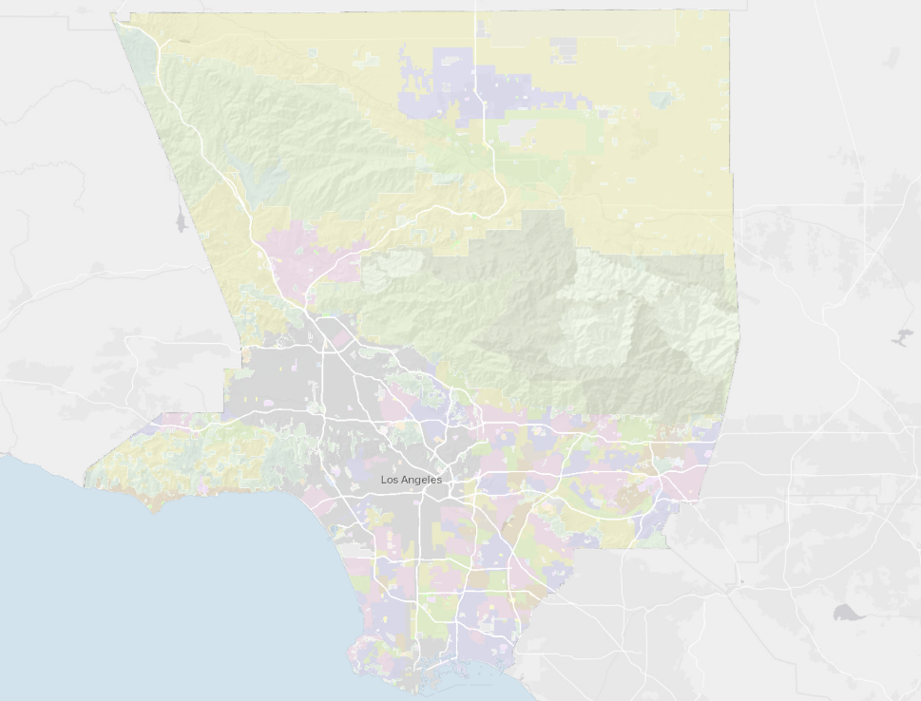
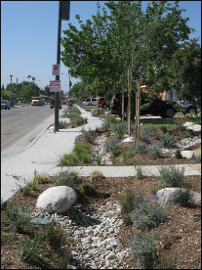
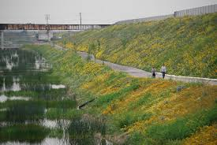
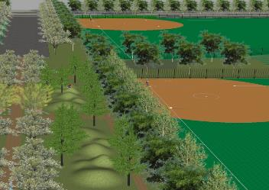
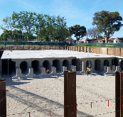
Sample Projects
ELMER AVE GREEN STREET
BASSETT HIGH SCHOOL
DOMINGUEZ GAP WETLANDS
Notes:
Dominguez Gap Wetlands – a large-scale project that uses nature-based solutions to treat polluted stormwater, increase local water supply by recharging the underlying groundwater, restores native habitat, and provides the community with new walking, biking, and equestrian trails.
Bassett High School – a medium-scale project that will include an infiltration basin under public school athletic fields to percolate treated water into the ground, and enhance the school grounds by improving existing recreational areas and adding features like outdoor classrooms and educational gardens.
Elmer Avenue Green Street Project – a neighborhood-scale project retrofitting a residential street to capture rainwater for treatment, reuse, and groundwater recharge.

Slide 15
Safe, Clean Water Program
Questions?
For additional information, please contact:
Dan Lafferty
dlaff@pw.lacounty.gov
626-458-4012
safecleanwaterla.com

Slide 16
Safe, Clean Water Program
EXTRA SLIDES FOLLOW

Slide 17
Stakeholder Process
Comment Period
Comment Period
Gov.
Gov.
Proj.
Proj.
Workshop
SAC 7
May 30th
Public Hearing
July 15th
SAC 1
SAC 2
SAC 3
SAC 4
SAC 5
SAC 6
DESI
DESI
Workshop
Cred.
Cred.
Subcommittee Meeting 1
Subcommittee Meeting 2
Program Development
16 meetings of the Stakeholder Advisory Committee
2 public Comment periods
>100 written comment letters
>100 public comments during the public hearing, many of which were in support of the measure

Slide 18
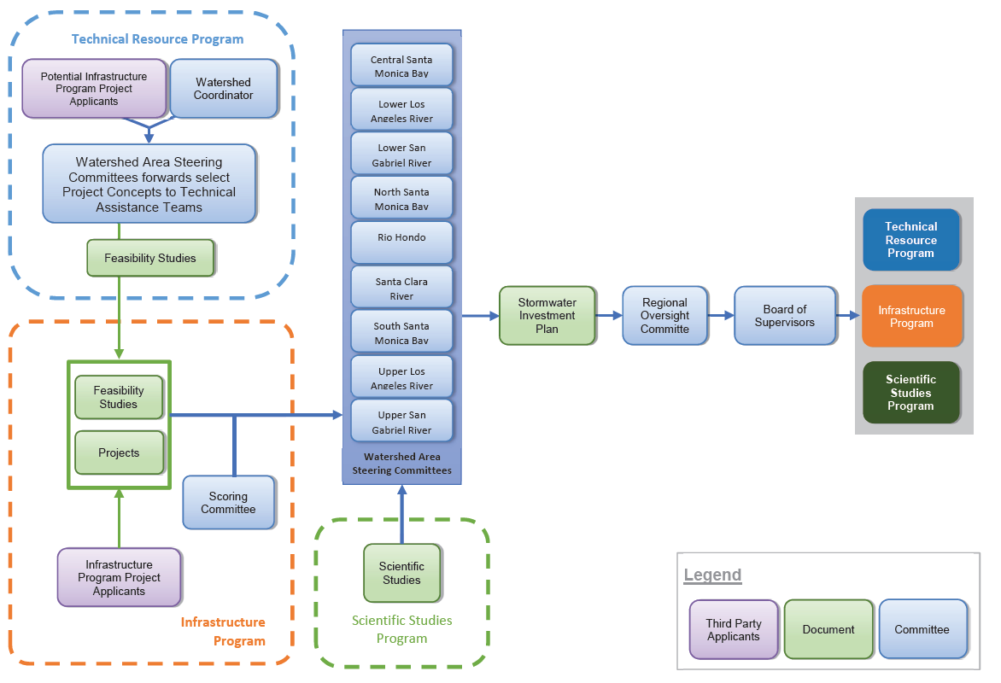
Regional Program Flow Chart
Notes:
Flow chart from Program Elements, but a great starting point to discuss governance further…
Board Appointments
Regional Oversight Committee (9 subject matter experts)
Scoring Committee (6 subject mater experts)
District will provide support to:
9 Watershed Area Steering Committees
Regional Oversight Committee
Scoring Committee
Consultant oversight for Watershed Coordinators
Technical Assistance Teams

Slide 19
Regional Program-Watershed Area Steering Committee Membership
Seven Municipal membership seats determined by impermeable area in the Watershed area (100% Watershed land area ÷ 7 seats = ~14%)

Slide 20
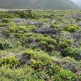

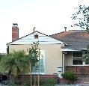
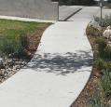
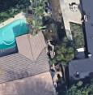


Taxing Impermeable Area
LA County Landcover Survey
Identifies
VEGETATION
SOIL
STRUCTURES
PAVEMENT
OTHER
Calculate Impermeable Area

Slide 21
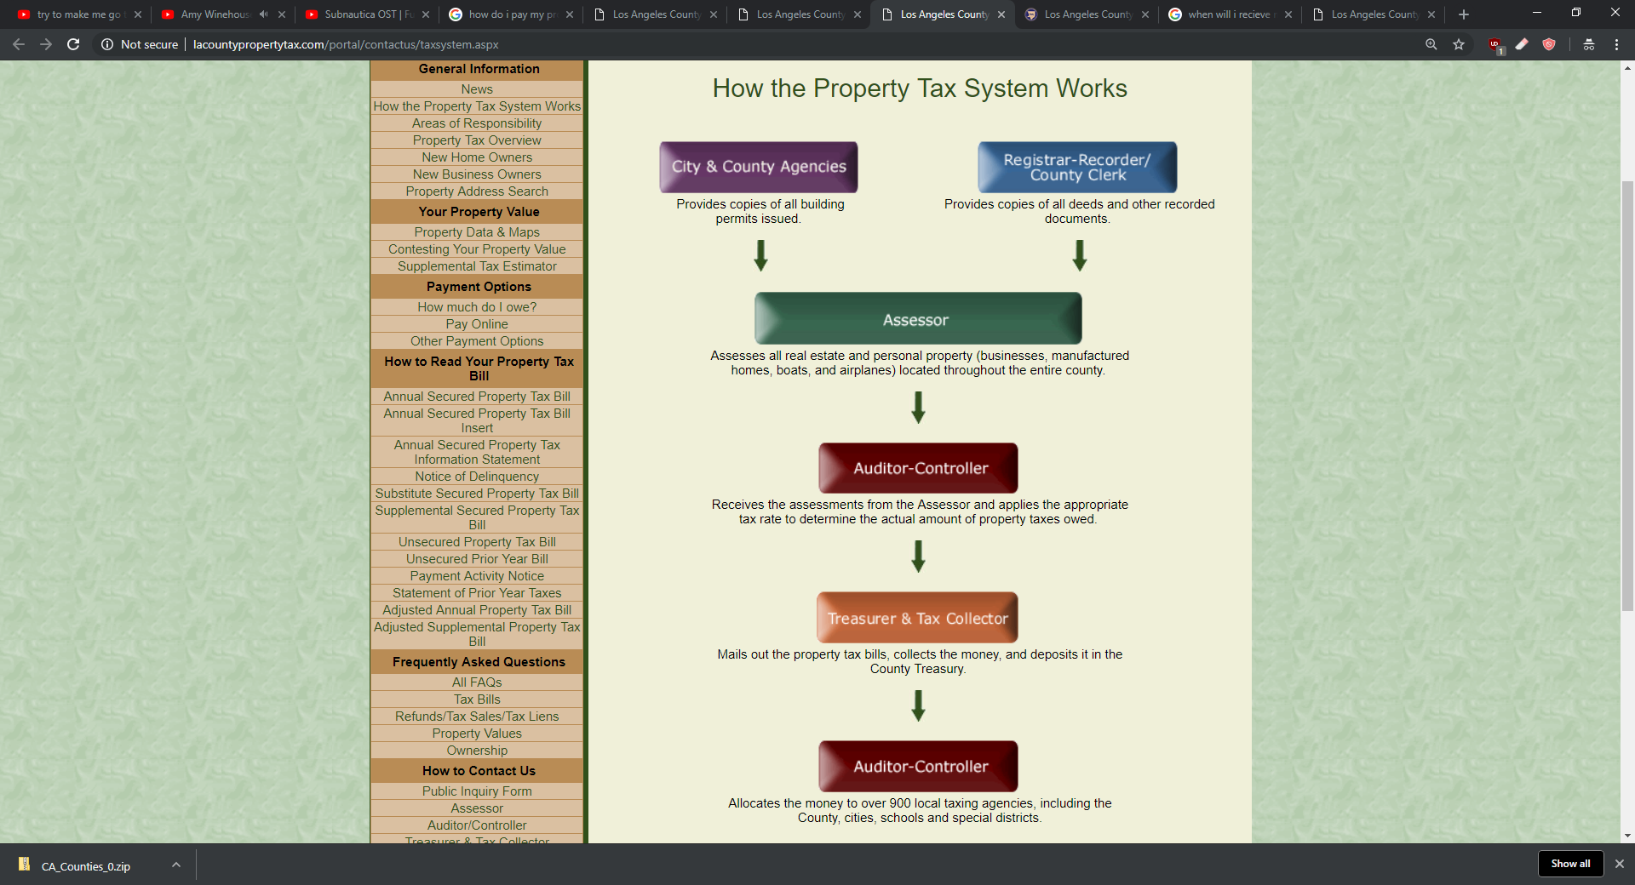
Public Works
Develops SCW Tax Amounts in coordination with Assessor & ISD

Slide 22
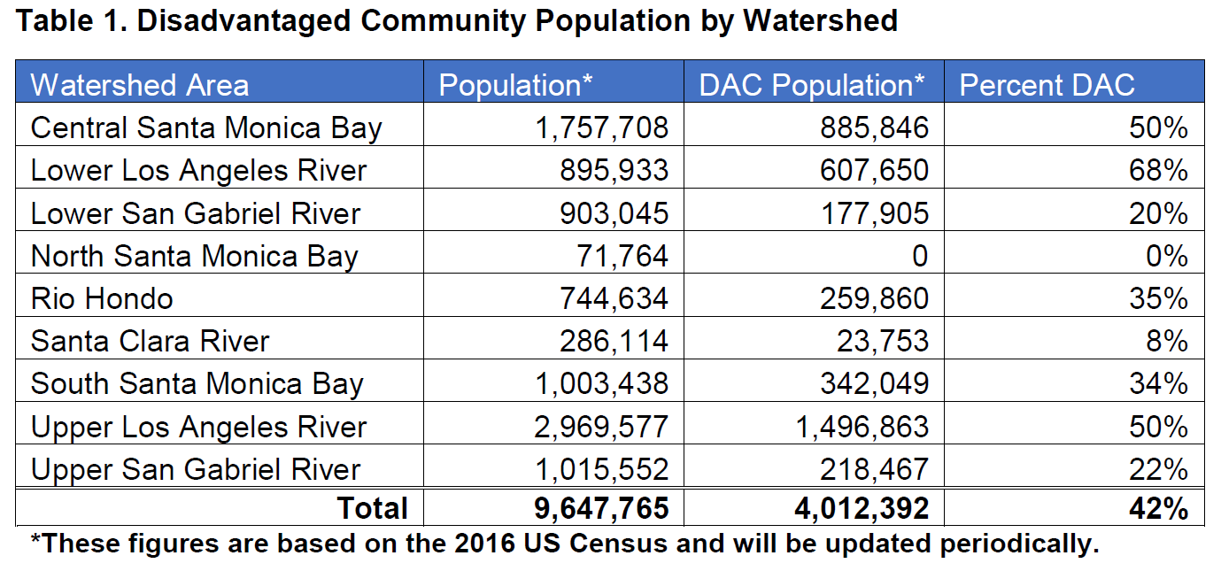
Safe, Clean Water Program – DAC populations
In the Regional Infrastructure program, funds for projects provided DAC Benefits must note be less than 110% of the ratio of the DAC population to the total population in each Watershed Area.
Notes:
DAC Return?
- Shall be allocated such that funding for Projects that provide DAC Benefits be not less than 110% of the ratio of the DAC population to the total population in each Watershed Area.
- Shall be programmed, to the extent feasible, such that each Municipality receives benefits in proportion to the funds generated within their jurisdiction, after accounting for allocation of the 110% return to DACs, to be evaluated over a ten (10) year period.

Slide 23
Tax Timeline Flowchart
Tentative Disbursement 1 of FY19-20 Revenue to Project Developers
Tentative Disbursement 2 of FY19-20 Revenue to Project Developers
2018
2019
2020
N
D
J
F
M
A
M
J
J
A
S
O
N
D
J
F
M
A
M
J
J
A
S
O
N
D
Public Works Develops 2019 SCW Tax Roll In Coordination with Assessor & ISD
Public Works Develops 2020 SCW Tax Roll In Coordination with Assessor & ISD
Nov 6:
Election
August:
Final 2019 Tax Roll Due to Auditor Controller
August:
Final 2020 Tax Roll Due to Auditor Controller
Nov 1: 1st Installment of Property Tax Bill Due
Nov 1: 1st Installment of Property Tax Bill Due
Feb 1: 2nd Installment of Property Tax Bill Due
Early October: Tax Bills Mailed to Property Owners
Early October: Tax Bills Mailed to Property Owners
Dec 10: Last day for 1st Installment of Property Tax Bill (Delinquency Date)
April 10: Last day for 2nd Installment of Property Tax Bill (Delinquency Date)

