Slide 1
TUNUA THRASH-NTUK
Executive Director
Email: LALISC@lisc.org
Website: www.lisc.org/los-angeles
Twitter: @LISC_LA

Slide 2
SUPPORTING SMALL BUSINESSES DURING COVID-19
A TOOLKIT FOR LOCAL GOVERNMENTS

Slide 3
MISSION
WITH RESIDENTS AND PARTNERS, LISC FORGES RESILIENT AND INCLUSIVE COMMUNITIES OF OPPORTUNITY ACROSS AMERICA -- TO CREATE GREAT PLACES TO LIVE, WORK, VISIT, DO BUSINESS AND RAISE A FAMILY.

Slide 4
LISC LA 2020 Impact
$128M Investment in Lending to Housing, Economic Development, Small Business and Grant-making to Small Businesses and Nonprofits
612 New Units of Affordable Housing

Slide 5
A TOOLKIT TO SUPPORT YOUR SMALL BUSINESS COMMUNITY
Defer all payments
If possible, we recommend deferring all payments due from small businesses into 2021 or beyond. This includes utility bills, taxes, fees, and outstanding loan payments. Business loans should be deferred, put into forbearance, or restructured in another way. Utility bills, business licensing fees, and taxes should be deferred.

Slide 6
A TOOLKIT TO SUPPORT YOUR SMALL BUSINESS COMMUNITY
Provide business assistance
Connect with technical assistance providers
Identify firms that can re-position to respond to pandemic supply needs

Slide 7
A TOOLKIT TO SUPPORT YOUR SMALL BUSINESS COMMUNITY
Invest low cost capital
During this emergency, businesses need financing that can be deployed quickly and at low or no cost. We recommend that all cities establish an emergency loan fund for small businesses immediately. Capital can be deployed out of general operating funds, CDBG block grants, and/or EDA funds. Loans can be structured as recoverable grants or low-cost/no fee micro-loans with flexible terms.

Slide 8
A TOOLKIT TO SUPPORT YOUR SMALL BUSINESS COMMUNITY
Form public/private partnerships
Set up - Loan pools for private firms to participate
Serve - As the guarantor on government backed loans
Raise - Grant dollars from philanthropy to provide grants

Slide 9
A TOOLKIT TO SUPPORT YOUR SMALL BUSINESS COMMUNITY
Establish a moratorium on evictions
Cities across California have either passed or are planning to pass motions that allow for a temporary moratorium on commercial evictions.
These moratoriums are not deferring rent payments, but rather prohibiting landlords from tenant evictions.
NEW:
Cities and counties could consider providing Main Street grants to small businesses for the purposes of helping to cover rent arrears and prospective rent.

Slide 10
A TOOLKIT TO SUPPORT YOUR SMALL BUSINESS COMMUNITY
Launch a "Call for Data" Program
Create a database of small businesses and to establish a direct line of contact with those that are most impacted by this pandemic.
The database will arm local governments with a robust source of data-backed information that can be leveraged for external reports, philanthropic requests, and internal planning purposes.

Slide 11
A TOOLKIT TO SUPPORT YOUR SMALL BUSINESS COMMUNITY
Initiate a "Buy Local Campaign"
Launch a social media marketing campaign
Partner with Business Improvement Districts
Support diverse chambers of commerce "Thai Tuesday"
Educate the community on health standards
NEW:
Promote policies that ensures that restaurants are using personal protective equipment in food prepeartion.

Slide 12
https://www.lisc.org/los-angeles/covid-19-response/keeping-our-shops/

Slide 13
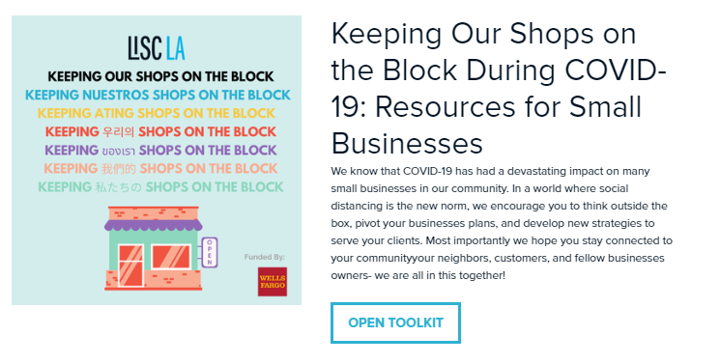
https://www.lisc.org/los-angeles/covid-19-response/keeping-our-shops/

Slide 14
KIVA.
A crowd funding platform

Slide 16
Email: LALISC@lisc.org
Website: www.lisc.org/los-angeles
Twitter: @LISC_LA

