Slide 1
Changing the Wildfire Prevention Paradigm
San Gabriel Valley Council of Governments
July 14, 2022

Slide 2
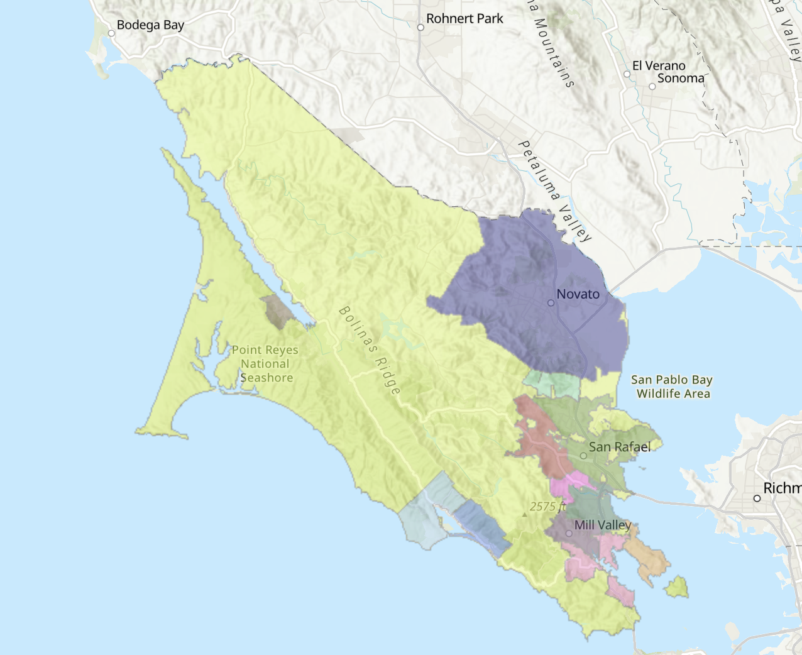
Working Independently
19 Independent Fire Agencies responsible for Fire Prevention and Suppression
Fire knows no jurisdictional boundaries
Compelling need to address common threats, mutual interests

Slide 3
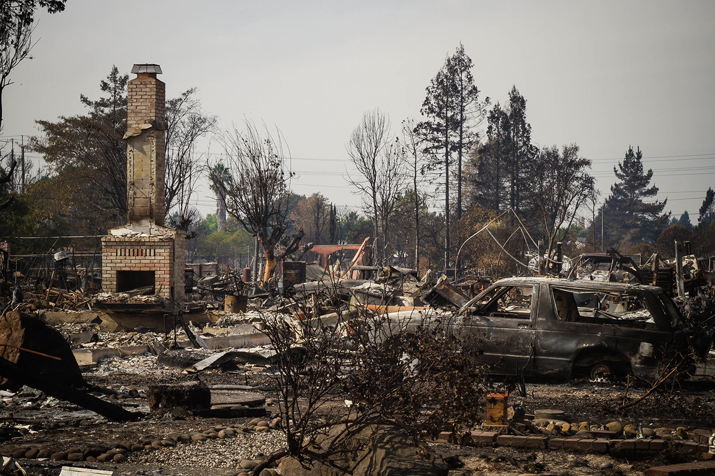
Why Change the Paradigm? Lessons Learned.
2017 Tubbs Fire, Coffey Park, Santa Rosa, CA
Photo: CC-BY The National Guard

Slide 6
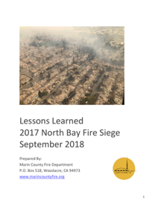
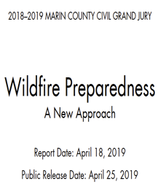
Lessons Learned from 2017 North Bay Wildfires
2018: Lessons Learned from the 2017 North Bay Fire Siege Report “When fires started October 8th the only thing separating Marin County from their neighbors to the north was simply an ignition source.”
Key Recommendations
Form a Joint Powers Authority
No single agency exists to coordinate fire prevention efforts
Need to integrate county-wide prevention and risk reduction work
Need an ongoing source of funding
2019: Marin Civil Grand Jury Report on Wildfire Preparedness
”…the creation of a joint powers authority to coordinate a comprehensive, consistent approach to pre-ignition planning."
Notes:
BOS subcommittee Lessons Learned
Convened to identify what gaps Marin has in their systems and planning – FIRE, LAW, OES, LMA
Several items addressed – although several that were in need of a countywide approach and funding
Grand Jury – independent analysis
Identified needs to for a new approach to deal with gaps in preparedness
Recommends new funding source, sales tax, JPA
What should we do to protect loss of life and property from fire? Wildfires start with an ignition event, and their severity is a function of three things: weather, topography, and fuel. The only one of these that we can influence is fuel.

Slide 7
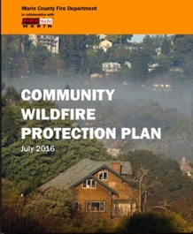
The Process: Plans and Policies in Place Pre-2017 (Tubbs Fire)
2016: Community Wildfire Protection Plan
“This document provides a framework for future collaboration that can be used to identify, prioritize, implement, and monitor hazard reduction activities throughout the county.”
Code Adoptions
Fire Hazard Severity Maps
Wildland-Urban Interface (WUI) ordinances
Notes:
Planning and Analysis Documents (all agencies contributed to and ALL acknowledge the problem w/ recommendations
CWPP
guiding document – priority recs will drive project implementation & $$
needed to apply for fed and state grants
used best available science to quantify/analyze the fire hazard and potential fire behavior under local weather scenarios
Used to prioritize projects to protect communities – but funding must be provided by individual jurisdictions/agencies
Pre-2017 discussions/efforts
Code adoptions, fire hazard severity maps, WUI ordinances

Slide 8
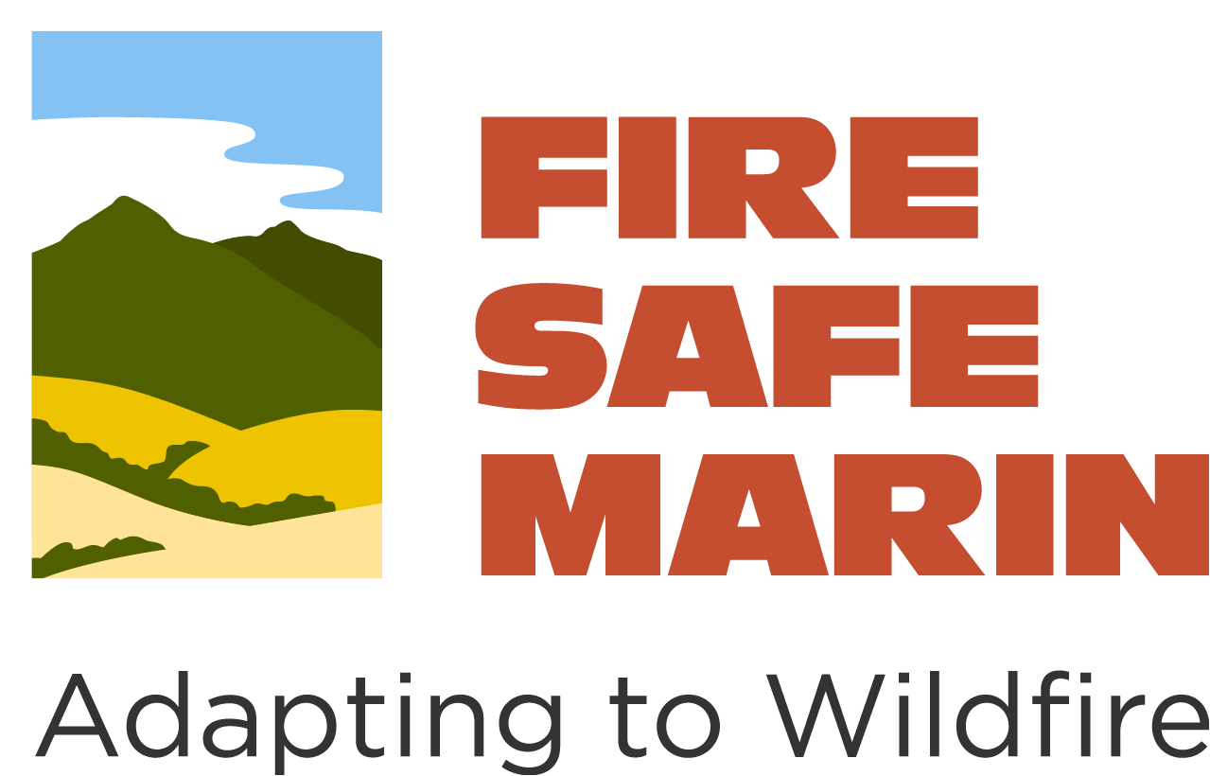
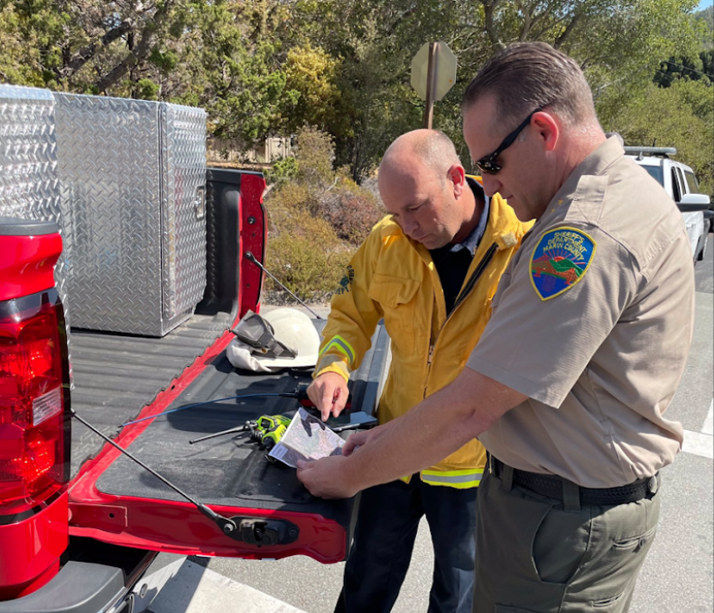
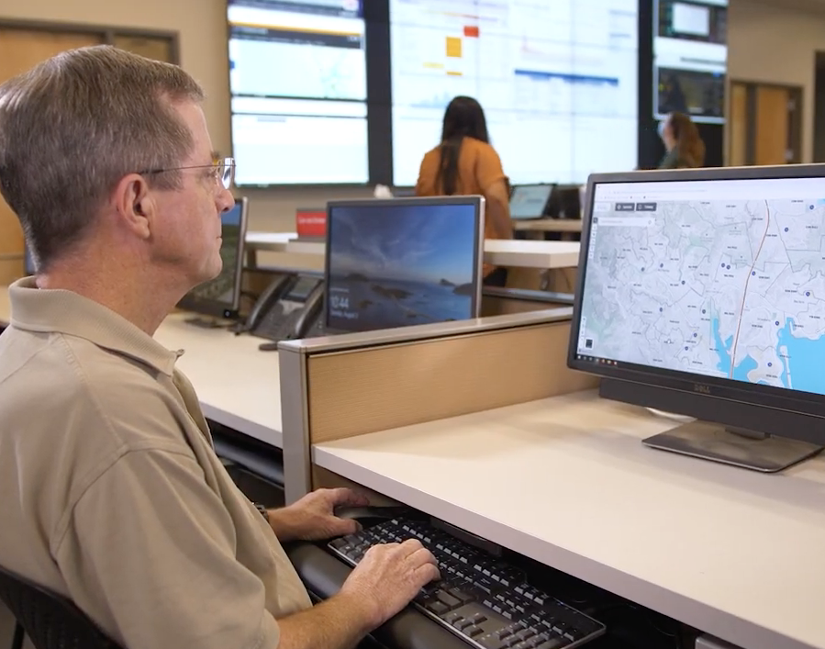
Building on Existing Relationships
Public Safety Community
One of the nation’s first Fire Safe Councils
Public outreach and education, Firewise communities
Trusted non-profit
Existing relationships with relevant agencies
Notes:
Pre-existing relationships in Marin
Fire agencies
Local government partnerships
Law enforcement partnerships – evacuation planning, alerts, OES
FIRESafe MARIN – one of the nation’s first Fire Safe Councils created after the 1991 Oakland Hills Fire

Slide 9
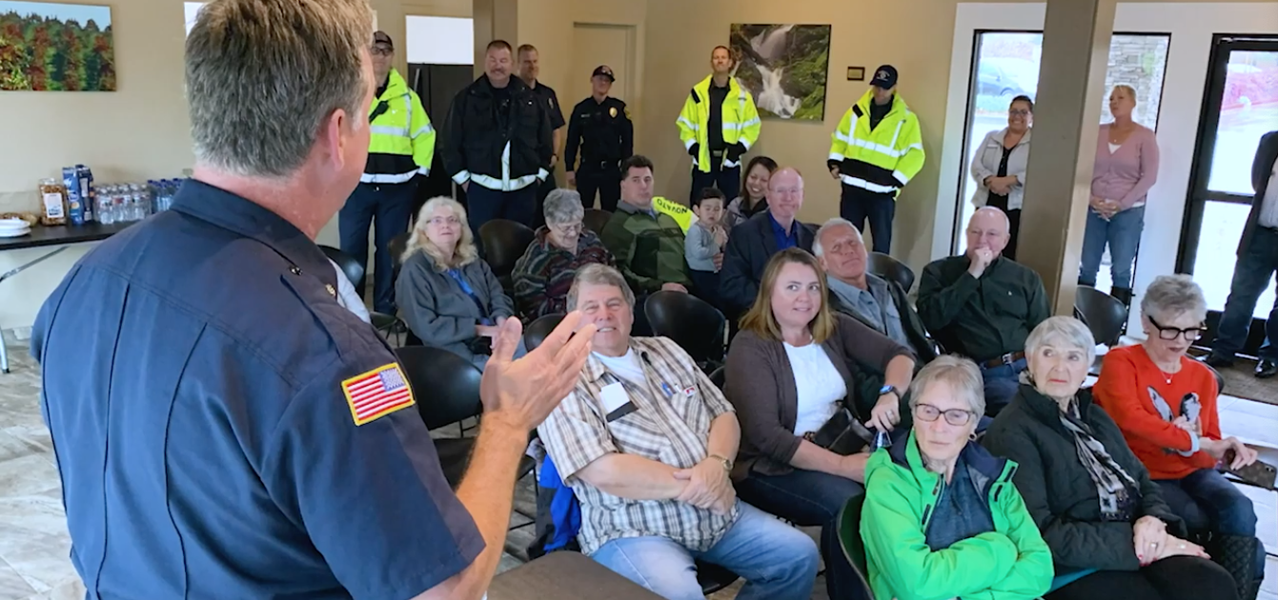
Building Support for a Joint Powers Authority

Slide 10
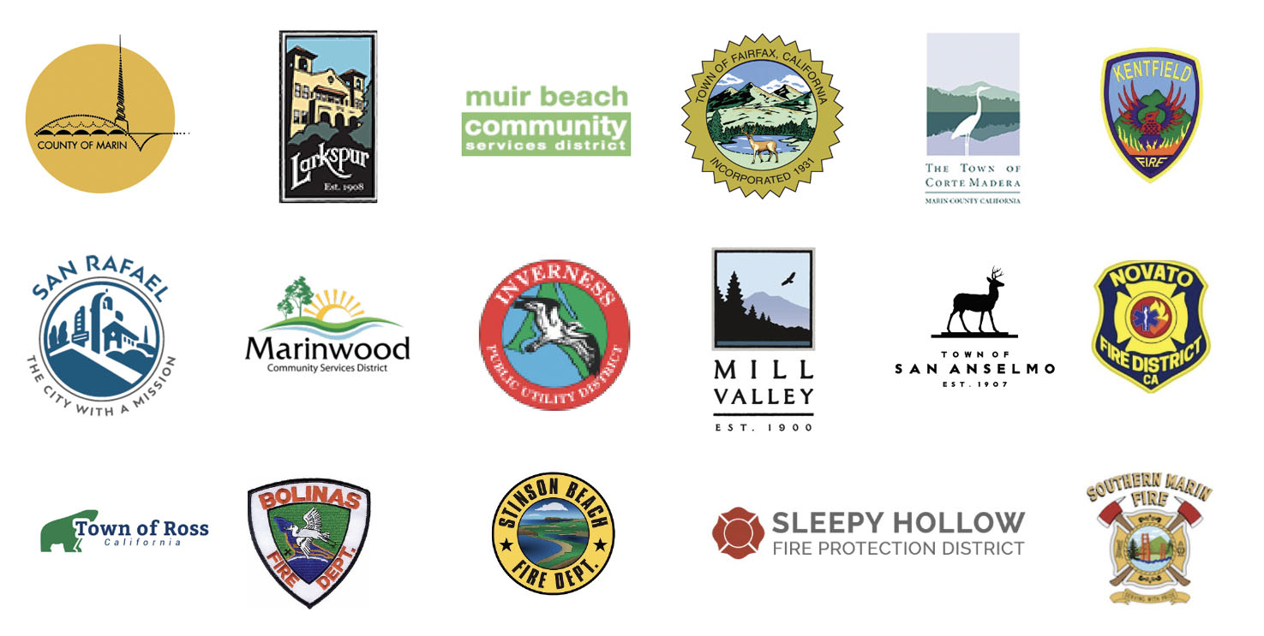
The Process: Crafting the Joint Powers Authority
City Managers and Fire Chiefs built the format of the JPA and language
Elected official oversight
Standing for subject-matter experts
Visits (times 2) to each board and council
Which agencies will be members of the JPA?
Which non-members need to be consulted?
What about the agencies that opt out?

Slide 11
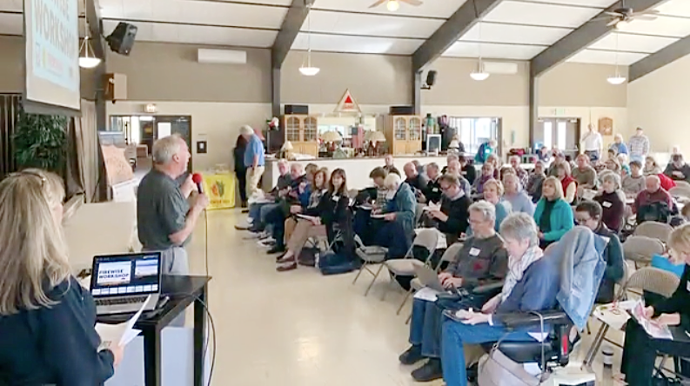
The Process: Campaign & Election
Civic leaders and Fire Chiefs campaigned Cities/Town Councils/Fire Districts for formation of a JPA
JPA to be funded by $0.10/square foot parcel tax
17 of 19 agencies agreed to join
Measure C – Marin Wildfire Prevention Authority received 70.8% voters’ support in March 2020
Notes:
Building the campaign
The election
What we learned about building the organization
Level of outreach was under-estimated

Slide 12
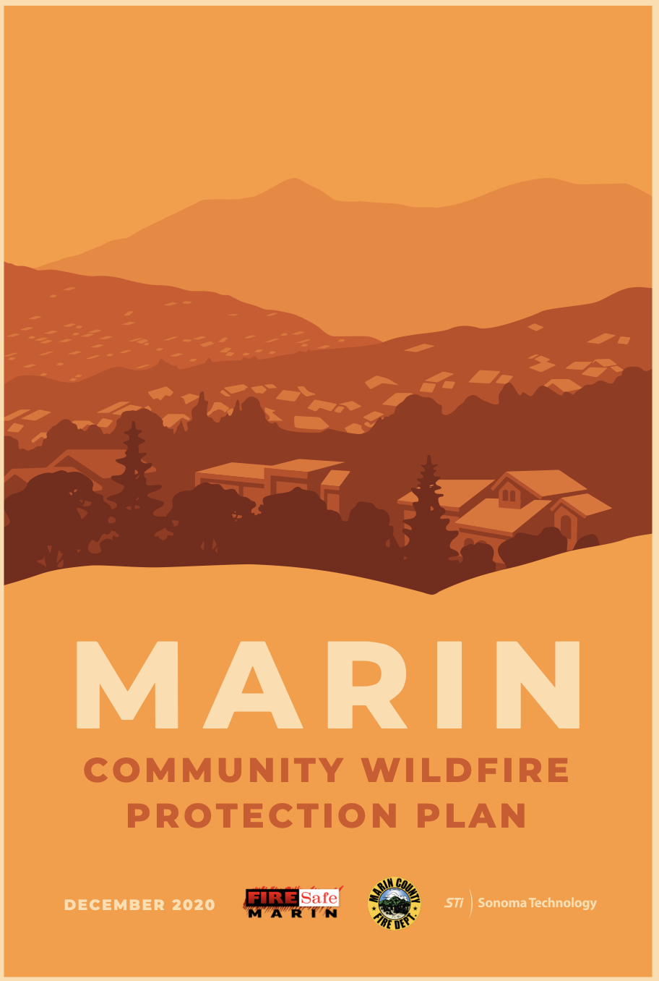
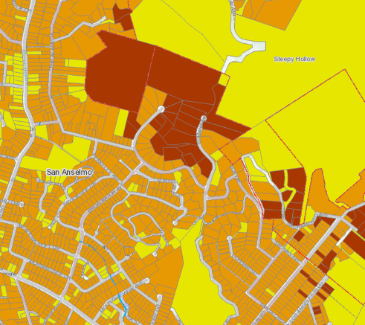
Guided by Community Wildfire Protection Plan (CWPP)
Marin County CWPP: Provides county-wide framework for MWPA's annual work plans and investments—updated annually.
LIDAR data: funded by a 2019 federal grant
Conducted a Fire Risk Assessment for every parcel and home in Marin
Identifies critical hazards & investments needed to reduce risks

Slide 13
MWPA Mission
The Marin Wildfire Prevention Authority leads the development of fire adapted communities using sound scientific, financial, programmatic, ecological practices, vegetation management, community education, evacuation and warning systems with the support of its member and partner agencies.
Land Managers
Manage landscapes for lowered fuel loads, lower fire intensity and ecological resiliency to fire.
Marin Residents
Modify homes to be more fire resistant. Be prepared and subscribe to alerts.
Civic Leaders
Develop laws and policies in support of fire prevention, preparedness and risk reduction.
First Responders
Craft fire prevention, preparedness, and emergency response plans. Educate community.
Developers & Business Owners
Don’t build in high-risk areas. Build with fire-resistant materials.
Leading the Development of a Fire-Adapted Marin

Slide 14
MWPA Goals Areas
Reduce Wildfire Fuels
Vegetation Management and Local Wildfire Prevention Mitigation
Improve Evacuation Systems
Wildfire Detection, Alert, and Evacuation Program Improvements
Reduce Risks to Homes
Defensible Space Evaluations (1/3 annually) and Home Hardening
Educate the Public
Public outreach and education about fire prevention, preparedness, and risk reduction
Provide Grants to Residents
Grants to modify homes and partnerships to collaborate and augment funds

Slide 15
MWPA: Organizational Structure
BOARD OF DIRECTORS
CITIZENS’ OVERSIGHT COMMITTEE
A Joint Powers Agreement clearly defines the JPA's authorities to operate, act and invest in wildfire prevention activities
Operated "From the Ground Up"
All sub committees' actions are defined by written Bylaws
All actions and investments are monitored by a Citizens’ Oversight Committee
We are now one year old
EXECUTIVE
OFFICER
EXECUTIVE COMMITTEE
EXECUTIVE
COMMITTEE
PLANNING AND PROGRAM
OFFICER
FINANCIAL OFFICER (SMFD)
FINANCE
COMMITTEE
FINANCE COMMITTEE
ADMIN ASSISTANT (SMFD)
OPERATIONS COMMITTEE
ADVISORY/ TECHNICAL COMMITTEE
Notes:
Organizational structure
Board of Directors, Committees, etc.
Vegetation management work is designed and proposed from the ground up

Slide 16
MWPA: Funding Allocations
Program Area | % of funds
JPA Core: Cross-Jurisdictional Projects Wildfire Detection & Evacuation Program Improvements, Veg Management/Fire Hazard Reduction, Grants Management, Public Education (Fire Safe Marin) | 60%
Defensible Space Evaluations and Home Hardening (agencies can administer) | 20%
Community-Level Wildfire Prevention Mitigation Local jurisdiction fire prevention issues with no funding. Enhanced fire patrols for problem areas, additional fire hazard reduction work, evac route parking issues | 20%
2020-2030: 10-year term
~$20 MM revenue per year
Year 1: Creating the framework for MWPA while implementing work on the ground

Slide 17
MWPA: Other Noteworthy Features
Grant Acquisitions/ Positioning
Environmental Compliance
Notes:
CalVTP, cat ex, possible program EIR

Slide 18
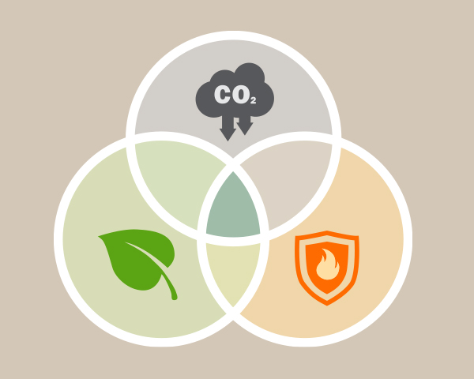
MWPA: Ongoing Stakeholder Outreach
Land Managers
Homeowners
Citizens & Orgs Concerned about Cost and Transparency
Advise About:
Wildland Vegetation
Carbon Management
Defensible Space
Ecologically-Sound Practices Partnership

Slide 19
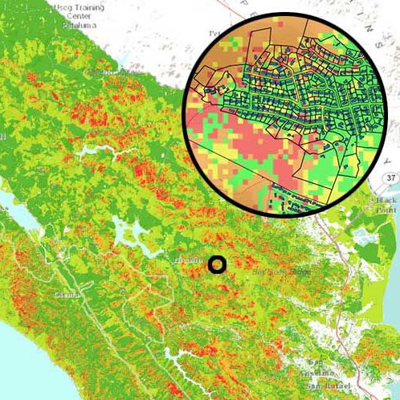
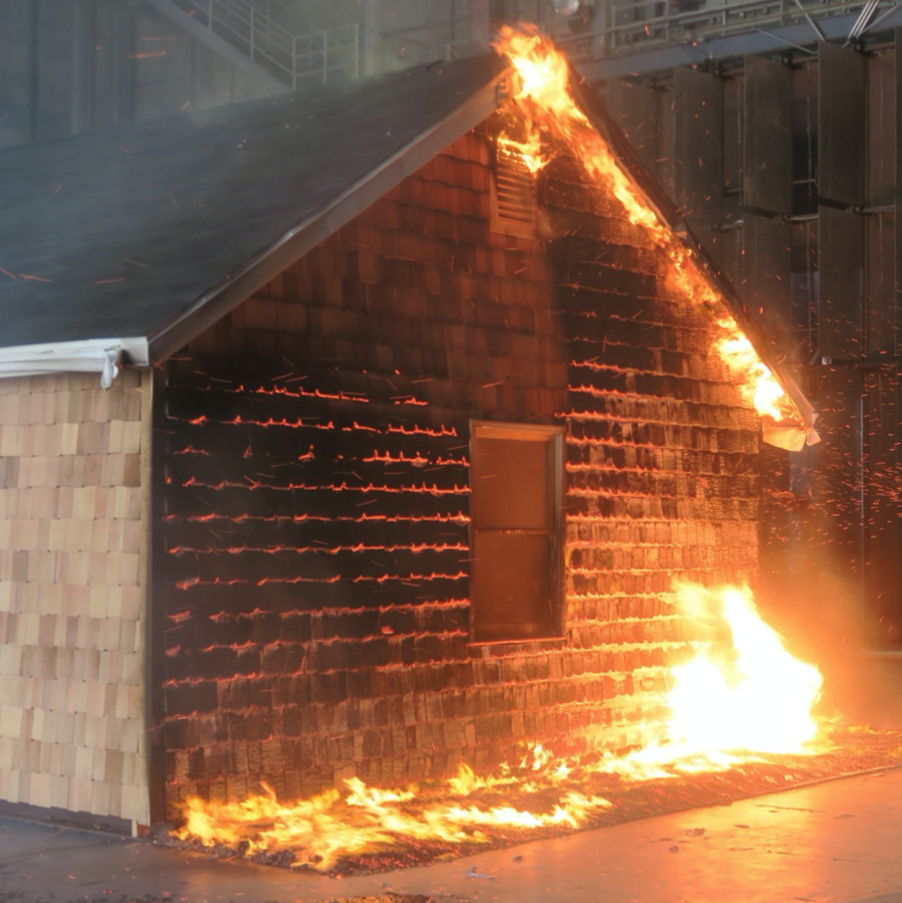
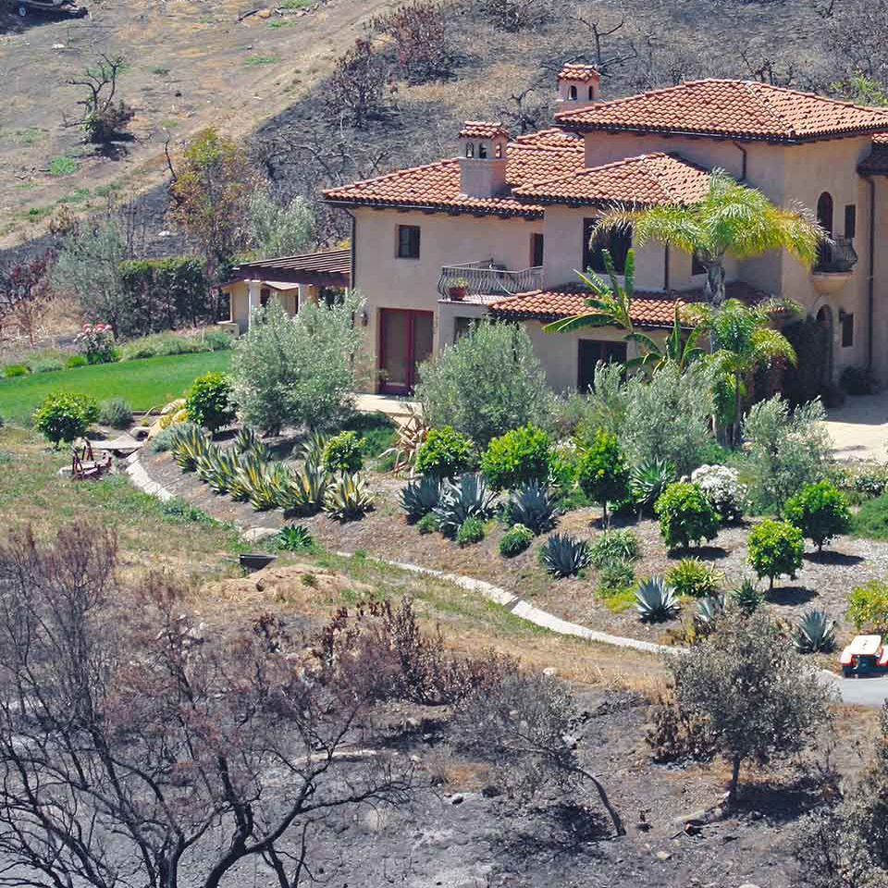
House Out Approach
Emphasizing importance of individual homes in preventing disaster
Parcel-level data
Harden Homes
Defensible Space
Grants to help low-income residents and those with access and functional needs to get it done
Notes:
Emphasize the importance of individual homes in preventing disaster. The plan contains dozens of maps detailing individual properties—showing wood roofs and unpaved roads, fire history, who is up for this year’s defensible space evaluations, and more. Combined with vegetation maps collected by public land managers, the data can be used to precisely model flame lengths and fire behavior in any weather scenario, and each resident can see their own fire risk. It’s a powerful tool.

Slide 20
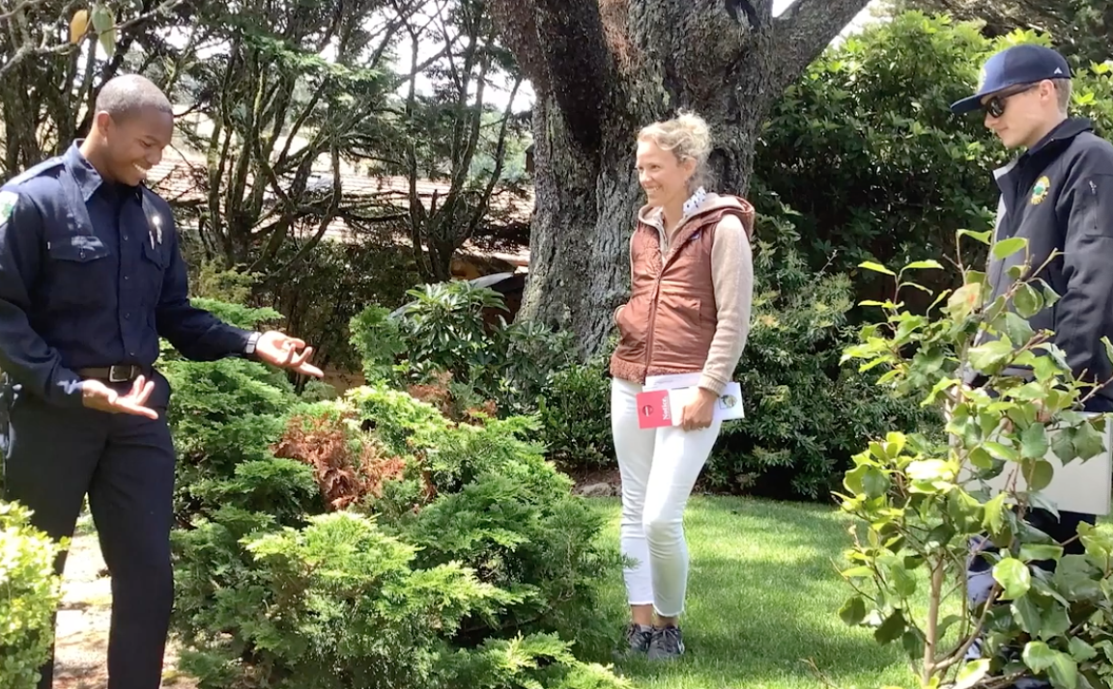
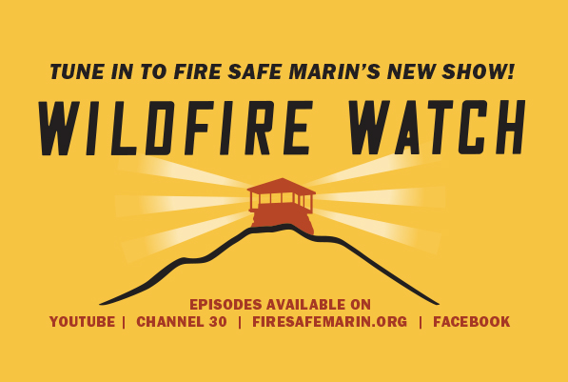
Public Education

Slide 21
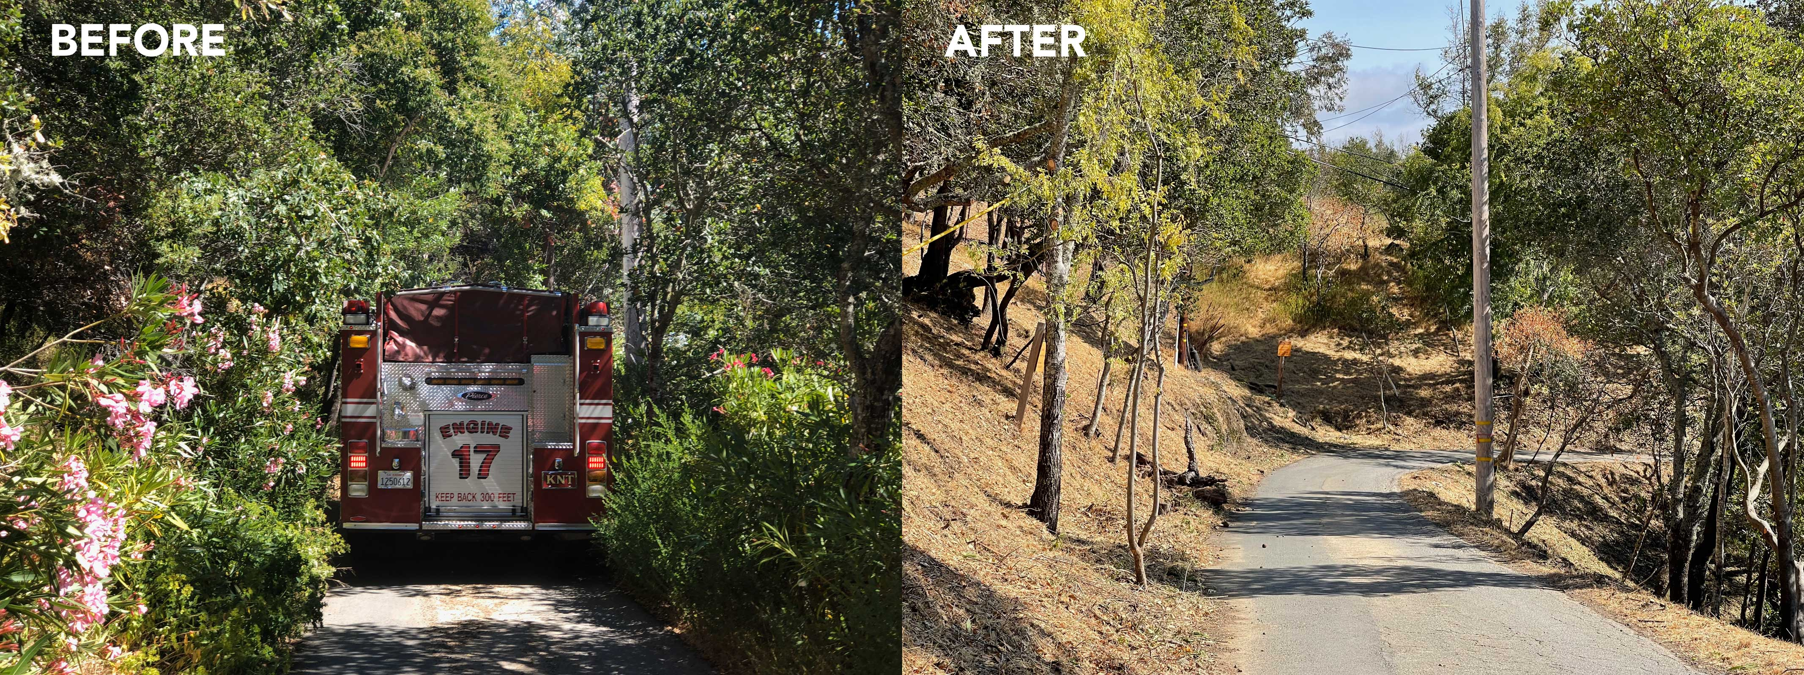
Evacuation Route Clearing

Slide 22
Evacuation Risk Assessment
Ingress/egress risk assessment
App development: Fire risk analysis to help prioritize projects
Roadway terrain and condition
Traffic patterns
Number of cars
Pinch points
Sync traffic preemption devices (i.e. green lights in a certain direction)
Demographics of community (such as access and functional needs)
Photo: Alan Dep, Marin Independent Journal
Lassen Fire, September 2021, San Rafael, California

Slide 23
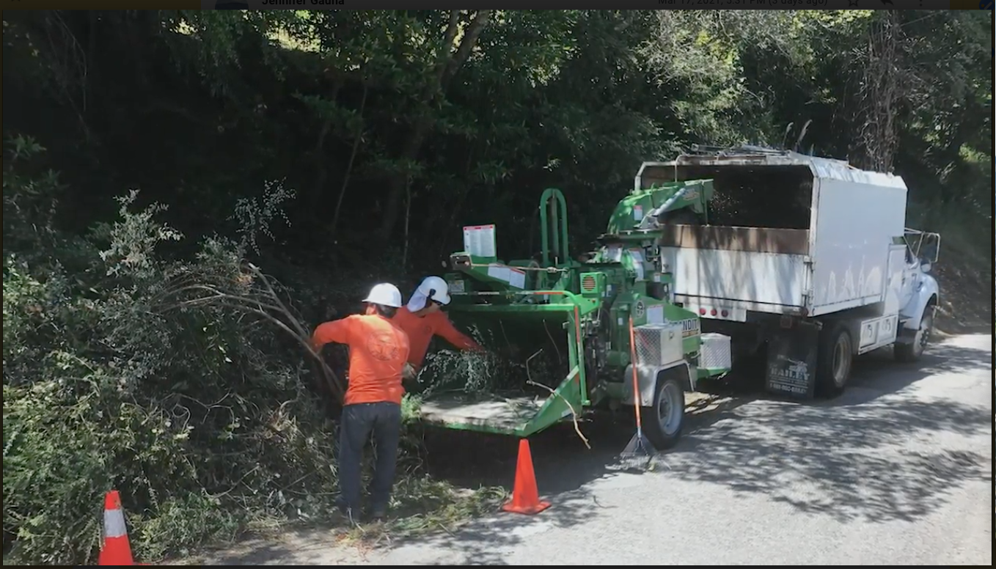
Local Fire Prevention/Mitigation Projects
Notes:
Prescribed burns?

Slide 24
Goat Grazing

Slide 25
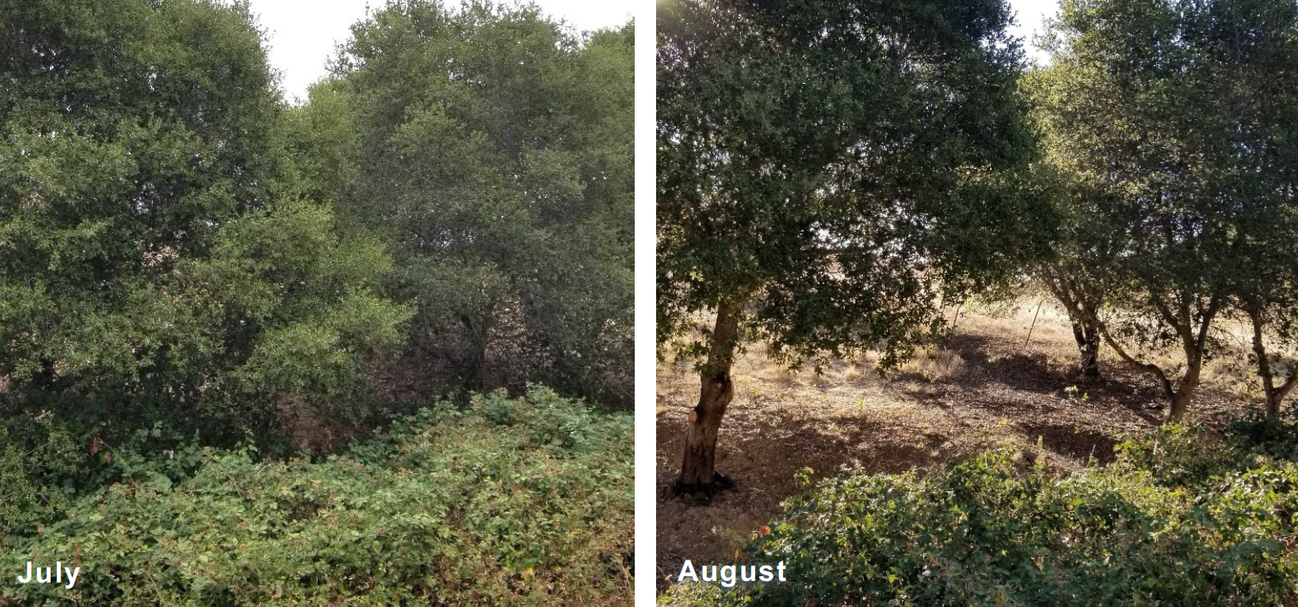
Shaded Fuel Breaks
Mount Burdell Open Space Preserve
2020 End of Year Report, Marin County Parks

Slide 26
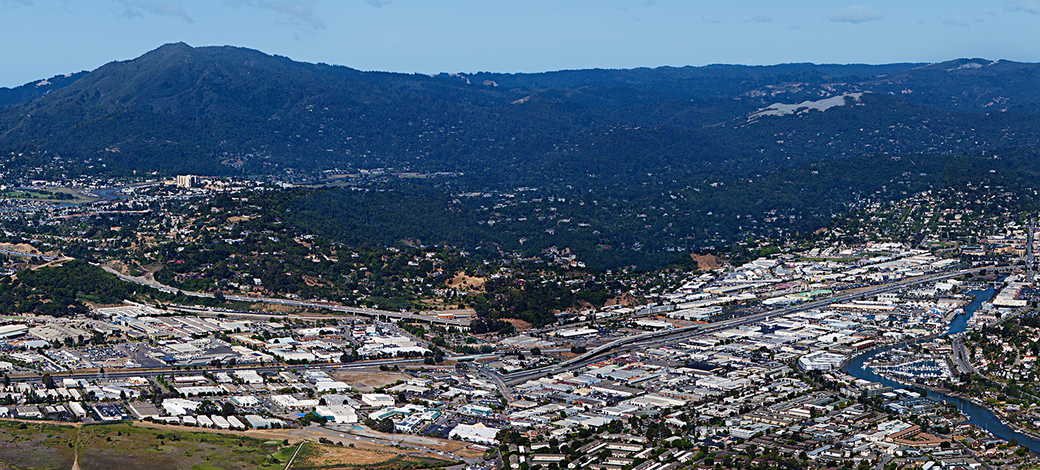
Changing the Wildfire Prevention Paradigm
San Gabriel Valley Council of Governments
July 14, 2022

