Slide 1
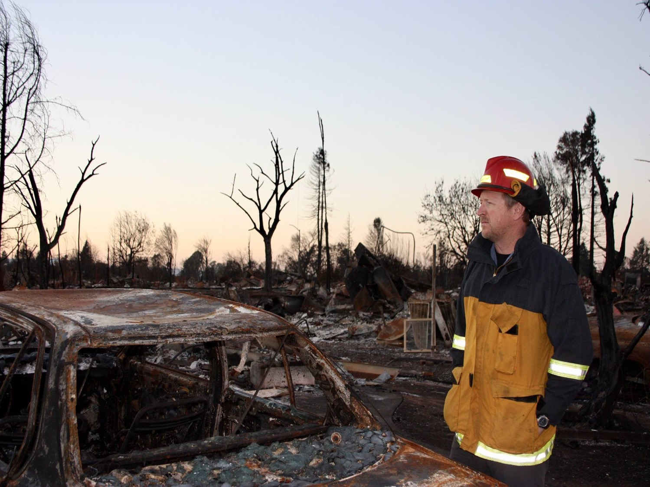
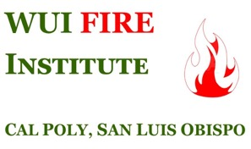
Planning for Fire in the Wildland-Urban Interface: Considerations for Local Government
Dr. Chris Dicus

Slide 2
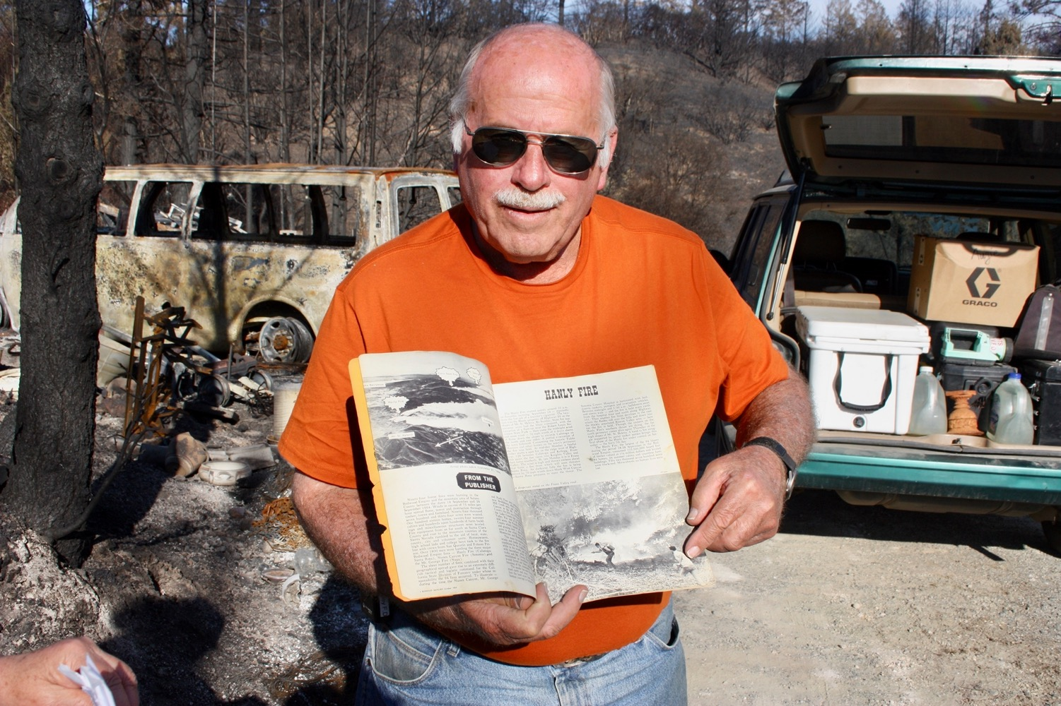
Those who forget the past…

Slide 3
Overreliance on the fire service
Residents (and fire service) beginning to understand that there will NOT be a firetruck in every driveway

Slide 4
We will NEVER fix fire problem with just more firefighters and equipment!!!
Coles Bay, Tasmania

Slide 5
We will NEVER fix fire problem with just more fuel treatments!!!
Coles Bay, Tasmania

Slide 6
Need holistic approach
Before the fire
Prevention
Mitigation
Preparedness
During the fire
Response
After the fire
Recovery
After Black Saturday 2009
Must consider
Biophysical
Sociopolitical

Slide 7
We must shape the battlefield!!!
300 Spartans = Firefighters
1.2 Bazillion Persians = Wildfire
Government agencies must avoid being at cross-purposes!!!

Slide 8
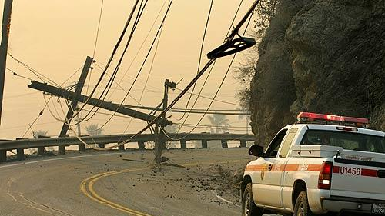
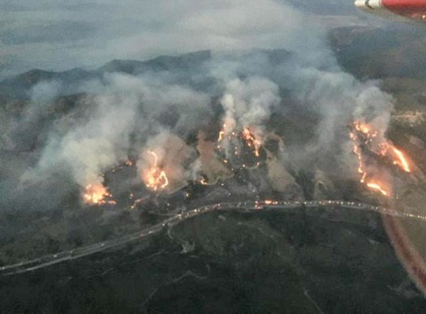
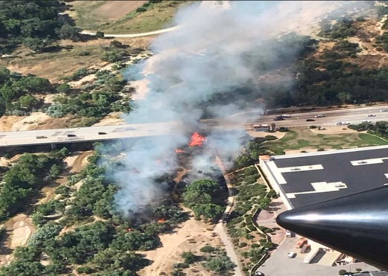
Prevention
>95% of wildfires in SoCal by people
Agencies and conflicting priorities…
Powerlines
Roadside
“Urban campers”
Notes:
http://vvng.victorvalleynews.netdna-cdn.com/wp-content/uploads/2014/05/10339331_10203601695743634_8434896859953818316_o.jpg
https://www.tdworld.com/sites/tdworld.com/files/styles/article_featured_standard/public/woodyard-images-and-after-pmo.jpg?itok=hZJe5RbE

Slide 9
Mitigation
To fire, vegetation is fuel
Defensible space enforcement
Better FireSafe Council efficiencies
To fire, structures are fuel
Chapter 7A of CA Building Code becomes standard for all
Retrofit incentives
Must consider MULTIPLE scales
Landscape-scale ok
LandSCAPING-scale best
Notes:
https://www.eastbaytimes.com/wp-content/uploads/2018/07/SJM-L-CARRSAT-0729-109.jpg?w=620

Slide 10
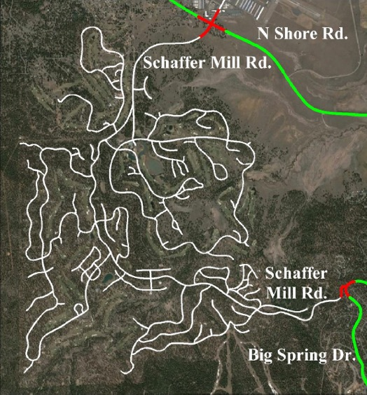
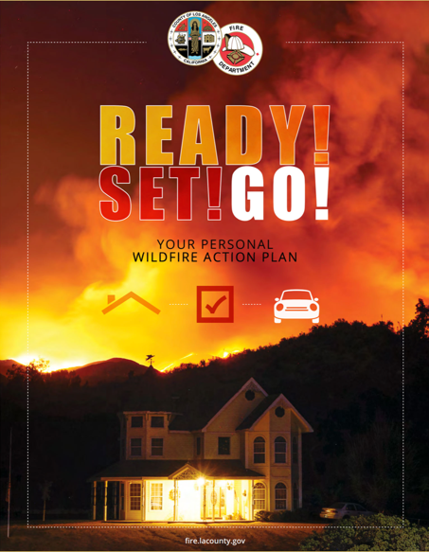
Preparedness
Evacuation planning/notification
Alternatives???
Vulnerable populations
Messaging to residents
Before, during, after fire

Slide 11
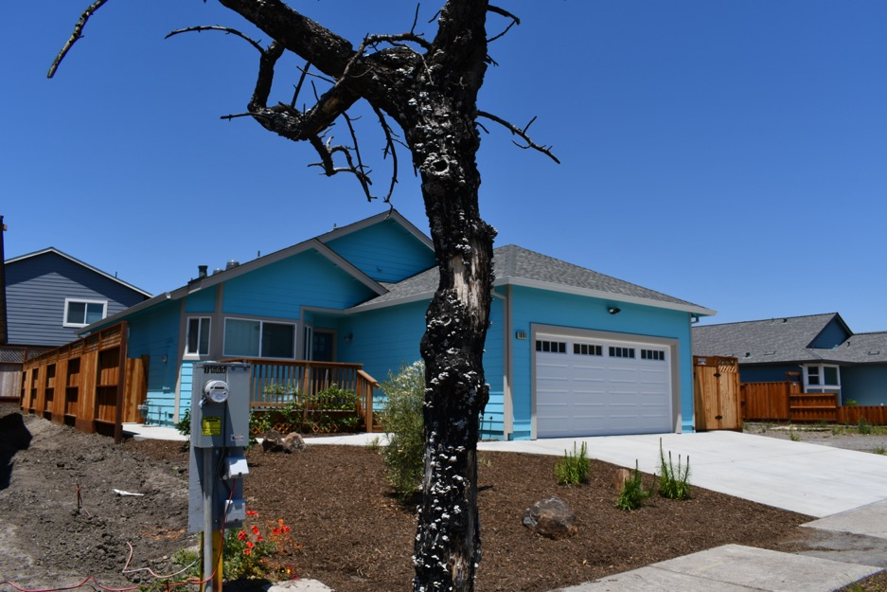
Recovery
MUST rebuild to new standards!!!
Being “good guy” sets up next disaster

Slide 12
More info???
For Local Governments
For Residents
https://www.usfa.fema.gov/stories/wui-report/index.html
https://defensiblespace.org

Slide 13
Human beings, who are almost unique in having the ability to learn from the experience of others, are also remarkable for their apparent disinclination to do so.
-- Douglas Adams, 1952 - 2001
Fire is not evil
Critical to most ecosystems
Society must learn to coexist

Slide 14
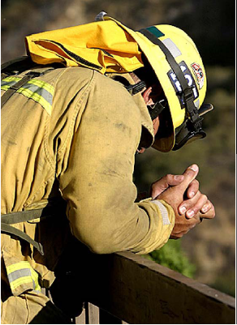
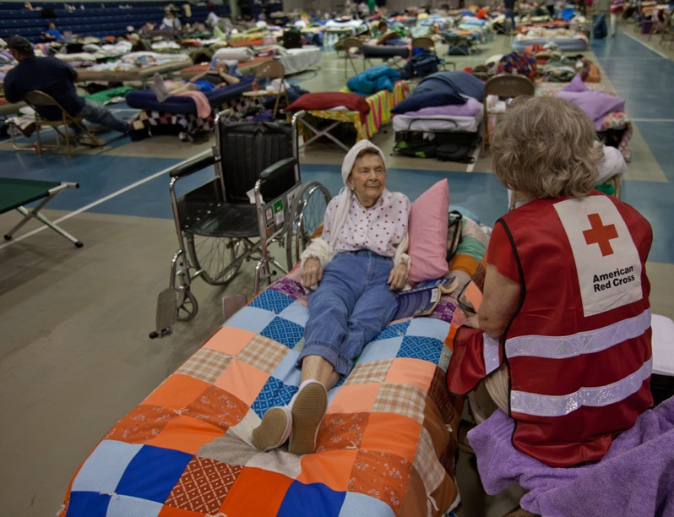
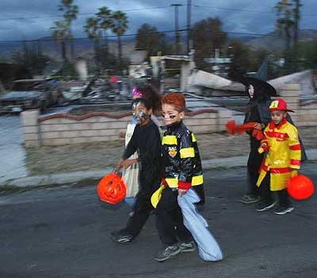
This doesn’t HAVE to be the “new normal”

