Slide 1
South Bay Cities Council of Governments Regional Broadband Initiative
San Gabriel Valley Council of Governments General Assembly
April 10, 2019

Slide 2
Spring, 2016 Wake Up Call
Business leaving Torrance cited poor quality, expensive network services as a reason for moving

Slide 3
Process to Address Network Deficiencies
Funding
South Bay Workforce Investment Board
Supervisor Mark Ridley-Thomas
Notes:
Move the situation slide ahead of this slide. Add a slide that describes the two tier program (subregional shared fiber ring/laterals; cities retain discretion to connect their constituents and city through the ring.

Slide 4
Situation
Applications development & deployment vary greatly among the SB cities
Many cities are purchasing less bandwidth than they actually need
Cities are paying too much for what they are buying, Average costs were ~$4,000/mo for far less than one gigabit of bandwidth service.
Demand will increase each year for the foreseeable future, making fiber optics an essential infrastructure component

Slide 5
Highlights 2016 - 2018
2016
Kickoff meeting with IT & Public Works Directors
Issue RFP for technical assistance, contract awarded to Magellan Advisors
2017
Fiber Optic Master Plan delivered
2018
RFP issued; 4 proposals received, 3 interviewed, negotiations begun with top ranked

Slide 6
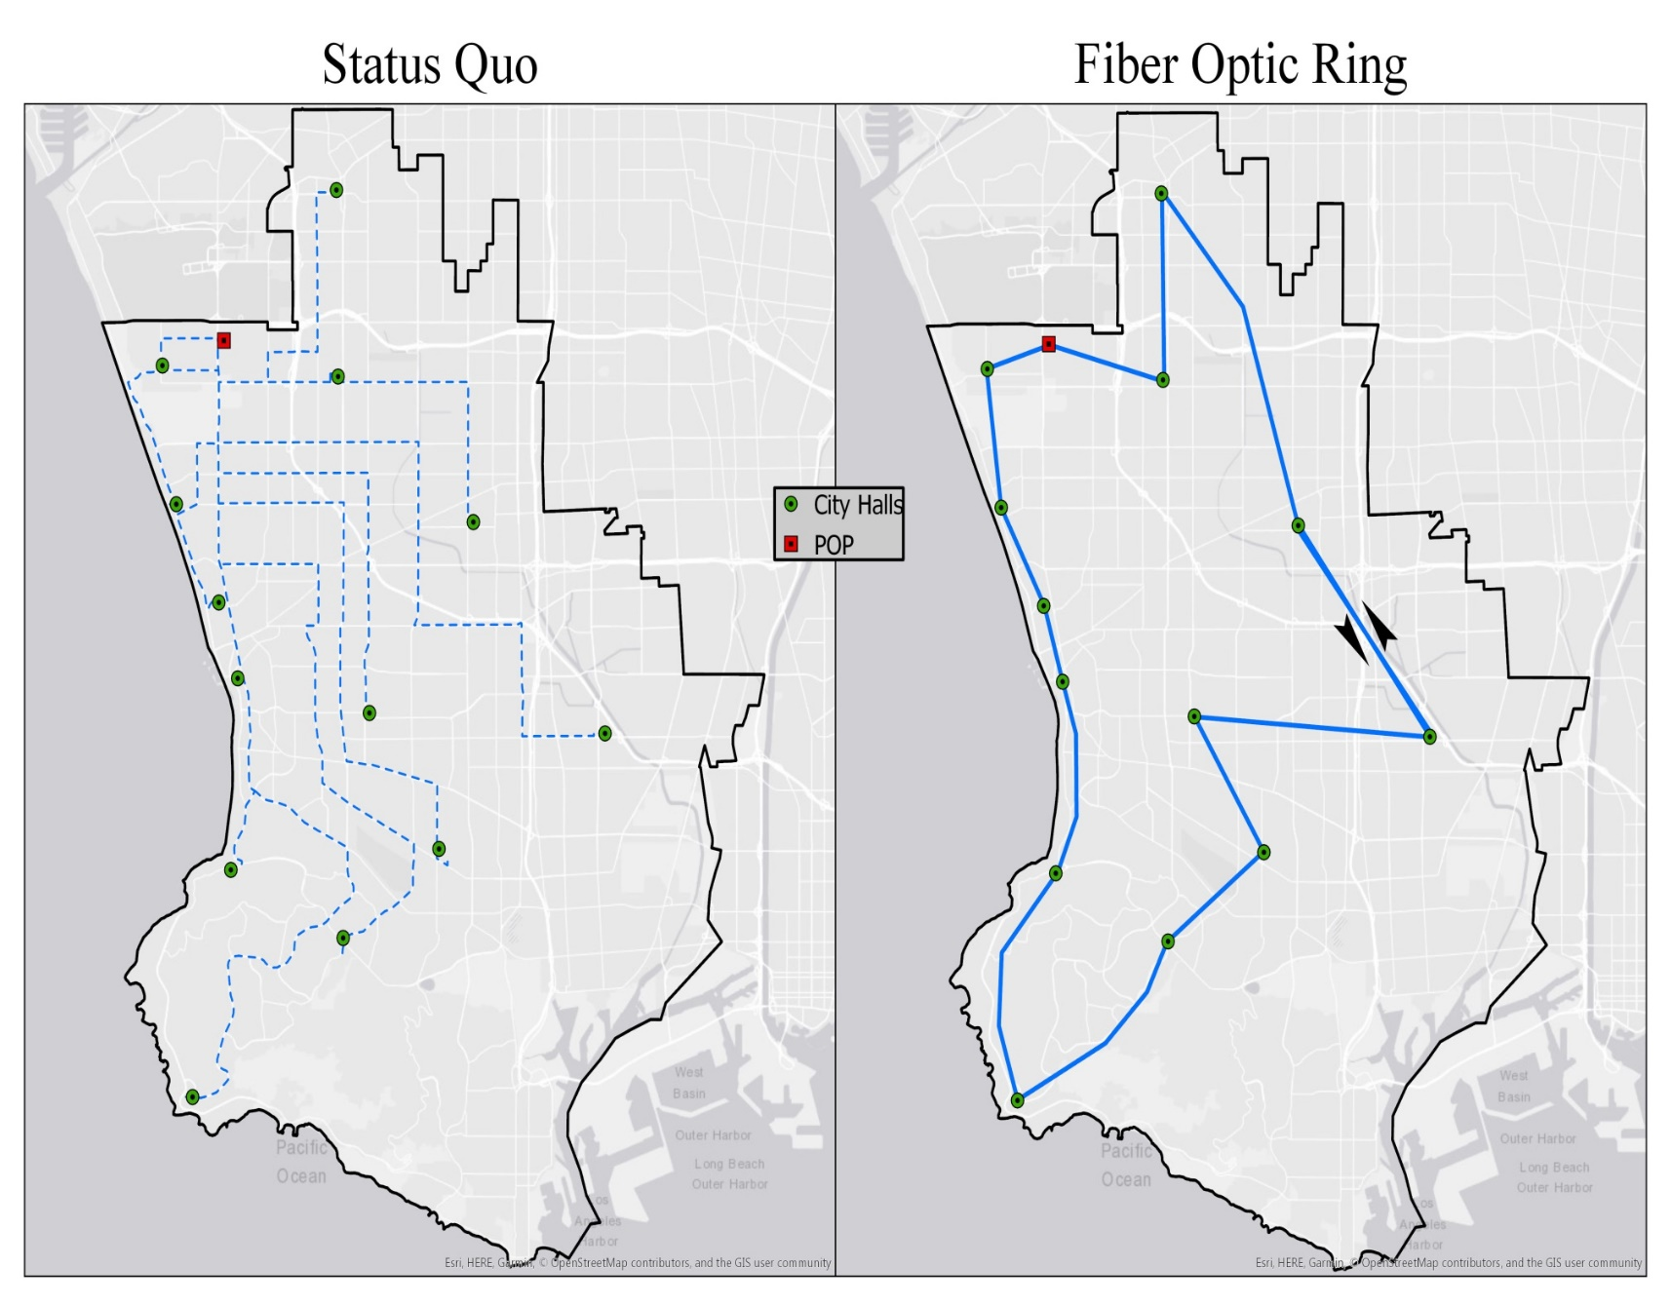
Notes:
Move this slide behind the new slide near slide 2 as part of the situation and initiative objective.

Slide 7
2019
Top proposer completes pricing including laterals
52 buildings in initial build, including Beach Cities Health District & UCLA Harbor General Hospital/LA BioMed
Negotiations with Metro regarding Measure M sub-regional funds for non-recurring (capital) costs.
Current status – most cities will be able to purchase 1 gig service (more than today) at about 50% of today’s market price

Slide 8
Deployment Opportunities
Two tier program: subregional shared fiber ring & laterals to local sites.
The backbone ring infrastructure can be used at city discretion for a build out to residences (Manhattan Beach) or commercial areas (Torrance).

Slide 9
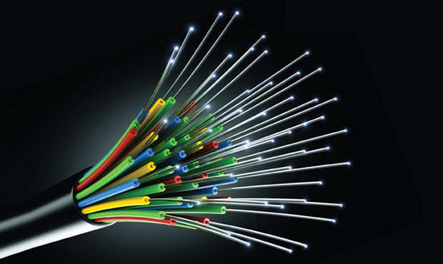
Fiber Optics -- In Plain English

Slide 10
About Fiber Optics- The Basic Infrastructure for the 21st Century
Fiber is future proof, a 100 year asset with unlimited capacity.
Policy tools to regulate the fiber market are no longer available, e.g., cities cannot require 100% build out.
Wireless is fiber dependent.
4G requires 1 antenna every 3 blocks
5G will require greater density of antennae on the order to 3 per block (9 to 1 ratio moving from 4G to 5G).
Fiber required to connect all the antennae back to a central switch.

Slide 11
Dollars and Sense
This current opportunity has been brought to this point through 2.5 years of a process funded by about $200K provided by the SBWIB and Supervisor MRT. If it fails to progress now, the opportunity may be impossible to repeat.
Measure M subregional funds are being applied for to pay the capital costs that will form the ring and pay for connections to 52 buildings in SB cities.

Slide 12
Using all that bandwidth
Improves Internet access
Supports cloud computing
Enables sensor deployment which will generate huge quantities of real time data to improve decision-making
Bandwidth demand will increase each year for the foreseeable future, making fiber optics an essential infrastructure component

Slide 13
Why Measure M?
Examples of Potential Transportation System Mobility Improvement Projects Enabled by the South Bay Broadband Ring and Laterals Project
Real-time activation of modified signal timing crossing plans for disabled / seniors
Real-time curb parking utilization monitoring and management and incident / special event management
‘Next bus’ bus stop systems
Changeable message signs for real-time traffic management
Smart Street Lights – real-time management of street lighting systems to improve safety and energy efficiency
Remote on-demand reversible lane management
Public infrastructure needed for Autonomous Vehicle vehicle-to-vehicle and vehicle-to-Infrastructure Management Systems
Real-time electric vehicle charging infrastructure utilization and availability for zero emission public fleets
Integrated, automated, real-time arterial street and ramp control at freeway ramps and adjacent arterial corridors intersections
Advanced motorist information, routing and detour management
Remote signal system health monitoring, re-timing and repair
Bikeways and Bike Route/Slow Speed Lane signal system infrastructure
Electronic Pedestrian Safety Infrastructure
Management of traffic detours during incidents, shutdowns or emergency evacuations
5G and 6G transportation / communications applications
Advanced signal synchronization and Control Infrastructure
Communications connections between transportation operations / emergency management centers
Advanced parking management systems to monitor utilization/vacant spaces in transit centers, park and ride lots, parking structures, freight and passenger loading zones
Evolution of transit centers into “Smart Transportation Hubs” for shared services, public transportation options, and Smart parking lots
Dynamic parking pricing programs that integrate public and private spaces in a neighborhood
Managed Lanes – HOV Lanes / Express Lanes
Real-time congestion pricing (virtual toll facilities) within cordons and on corridors
Goods Movement management (delivery appointment systems, delivery zone management)
Real-time paratransit dispatch and route monitoring (dial-a-ride, senior / disabled capital projects)
On-demand micro-transit management of ride hailing pick up locations / virtual stops
Car sharing / ridesharing / vanpool / telecommuting communications applications
Public infrastructure to support TDM strategies (remote work sites, work at home, virtual meetings, etc.) – The Trip Not Taken
Mixed flow, slow speed and bike lane capacity utilization monitoring
CCTV monitoring of intersections and high-risk transportation zones
Automated traffic counting and delay calculation applications for all modes (trucks, buses, cars, bikes, mobility devices, pedestrians) in all travel lanes and crosswalks
Resiliency: A Fiber Network improves reliability and resiliency of the transportation system control network through increased speed of diagnosis and repair, and improved human efficiency in the network maintenance and security administration.

Slide 14
Transmission of Place – The Trip Not Taken
Facilitates virtual presence which will reduce congestion
Telecommuting – more telecommuters than transit riders
Distance education
E-government
Digital medicine
Example “Tele-Orthodontics”

Slide 15
Why Collaborate?
City scale matters (LA, LB) among the largest cities
Leadership matters (CC, SM) among smaller cities.
The SBCCOG is the best way for small cities to act large and can provide the leadership for applications development and data analysis

Slide 16
Next Steps
April
Contract review by cities
April/May
Final negotiations
May
Funding approval for Measure M funds
Decision by cities with contract approval
June
SBCCOG Board recommends award based on funding secured
July 1
Execute contract and cities approving their riders
Notice to Proceed

