Slide 1
REBUILDING LIVES.
ENDING HOMELESSNESS.
SPOTLIGHT ON THE PRESENT
Notes:
To help individuals and families rebuild their lives and end homelessness. As the San Gabriel Valley’s largest, most comprehensive homeless service agency assisting homeless and very low-income adults and families, Union Station has helped thousands of people find and retain housing, and reclaim a sense of belonging in our community. To begin today, I’d like to show you some of our highlights along the way, starting back in 1973.

Slide 2
OUR MISSION
UNION STATION HOMELESS SERVICES
OUR MISSION
We prevent and end homelessness by focusing on permanent solutions: housing, supportive services, employment, and community engagement.

Slide 3
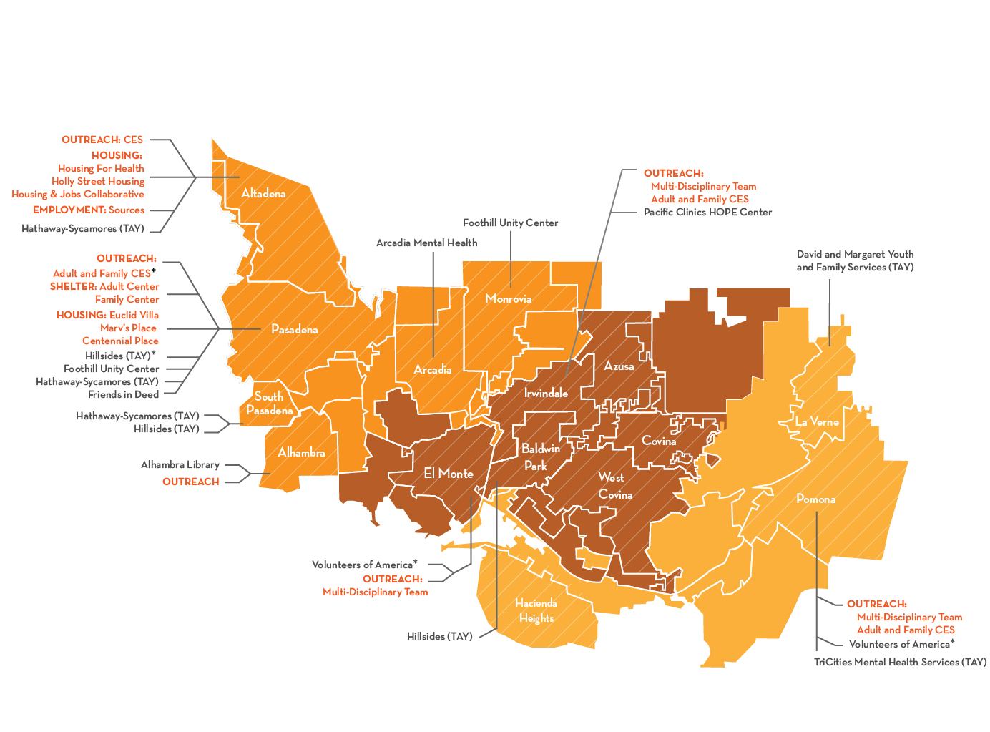
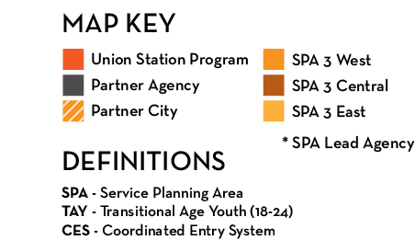
SPOTLIGHT ON THE PRESENT
UNION STATION TODAY
OUTREACH:
West Covina Library
Notes:
In 2014, Union Station was chosen to serve as the lead agency for the Coordinated Entry System in the San Gabriel Valley, working with over 60 agencies in the area to match individual needs to available services throughout the region.

Slide 4
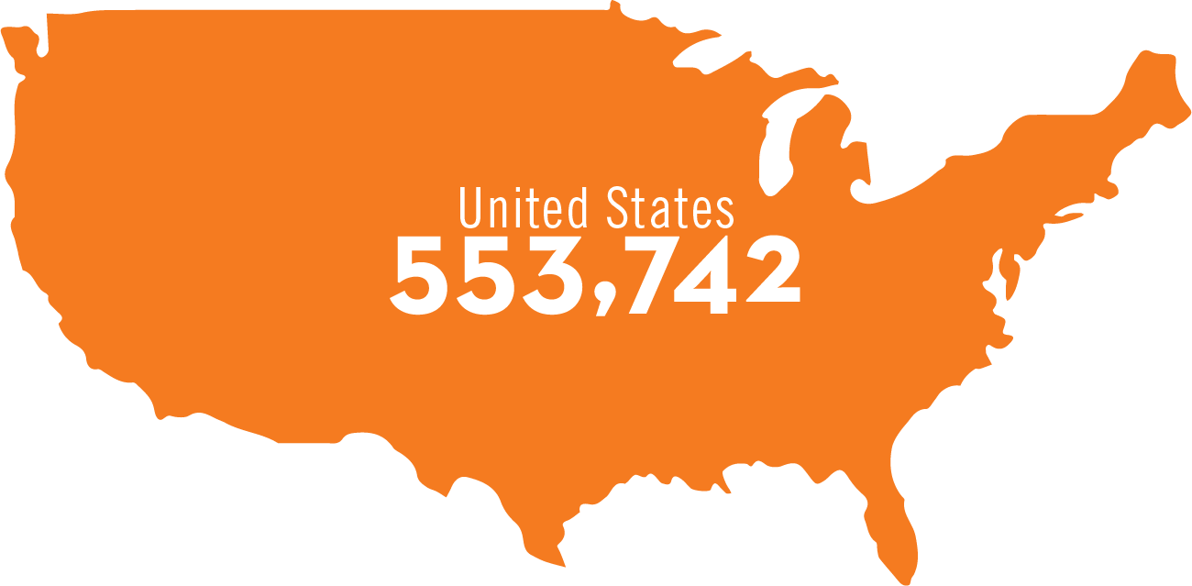
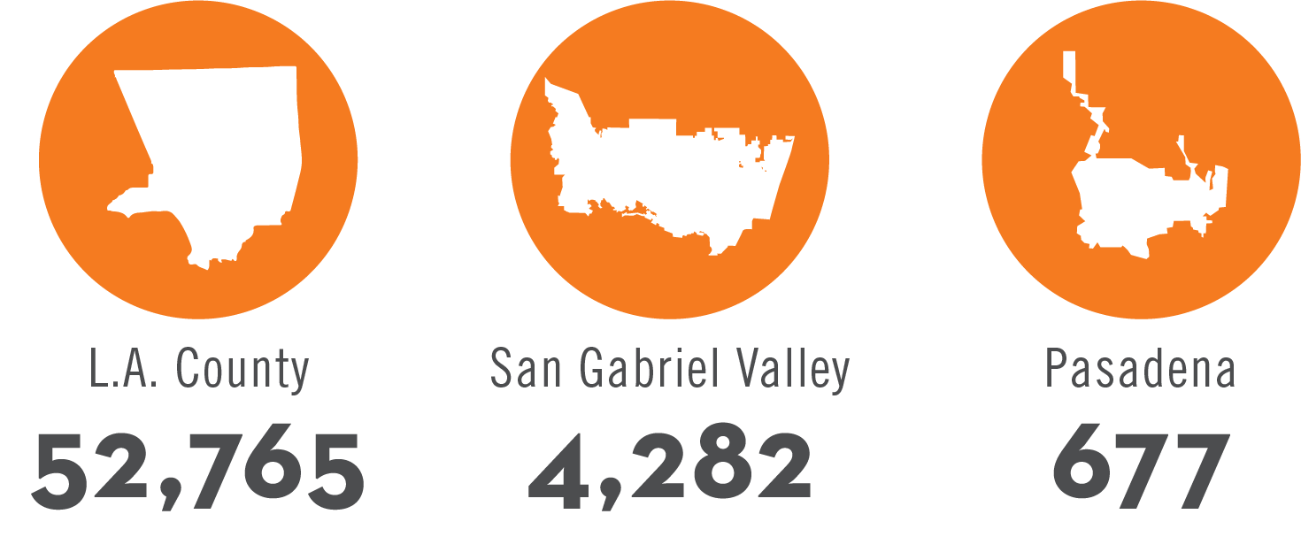
SPOTLIGHT ON THE PRESENT
UNDERSTANDING HOMELESSNESS
Los Angeles has the largest population of
unsheltered people in the USA.
Notes:
First, let’s start with a basic question: what is homelessness?
Homelessness is generally defined as "lacking a fixed, regular, and adequate night-time residence.“
Fixed, meaning immovable, or, for example, not a tent or vehicle
Regular, meaning able to be counted upon, so not a shelter, housing of friends or family, or other temporary dwelling space
Adequate, meaning suited to the needs of the individual or family

Slide 5
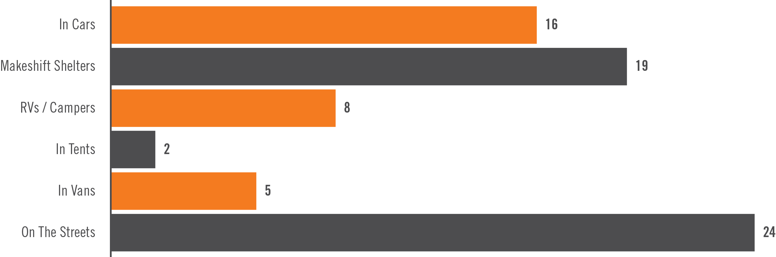
SPOTLIGHT ON THE PRESENT
CITY PARTNERSHIPS: ALHAMBRA
IN 2017…
Alhambra had 89 people experiencing homelessness in an alarming upward trend.
89
2017
Homeless Count

Slide 6
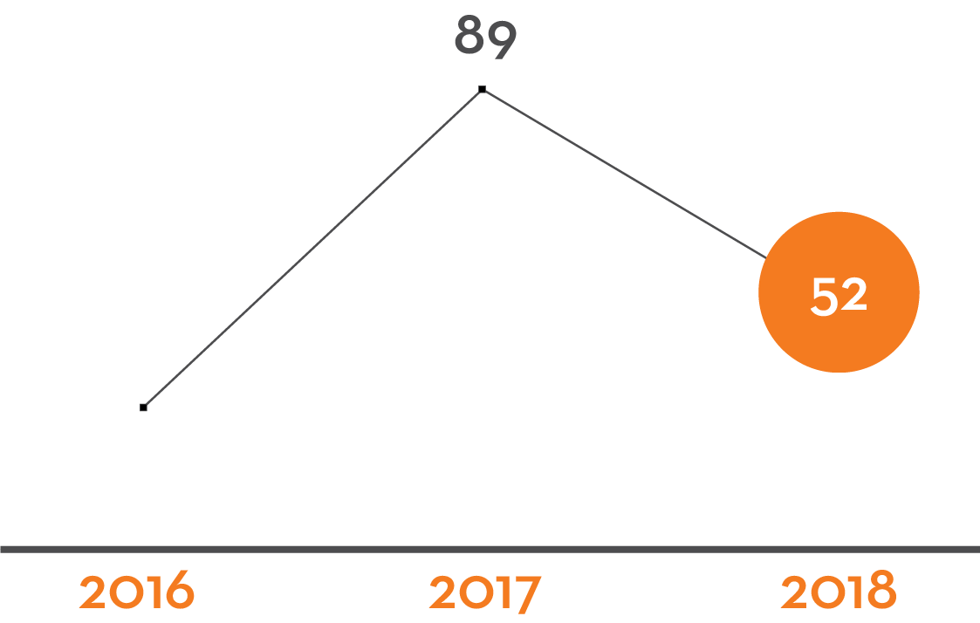
SPOTLIGHT ON THE PRESENT
CITY PARTNERSHIPS: ALHAMBRA
IN 2018…
Alhambra saw a 41.6% reduction in the number of people experiencing homelessness!
!
52
2018
Homeless Count

Slide 7
SPOTLIGHT ON THE PRESENT
CITY PARTNERSHIPS: ALHAMBRA
WHAT
CHANGED?

Slide 8
SPOTLIGHT ON THE PRESENT
CITY PARTNERSHIPS: ALHAMBRA
In 2017, the City of Alhambra contracted with Union Station Homeless Services.
HOME TEAM
FULL TIME STAFF IN ALHAMBRA
WORK WITH CITY DEPARTMENTS
HOPE TEAM (Homeless Outreach Psychiatric Evaluation)
REGULAR CHECK-IN MEETINGS BETWEEN USHS/CITY DEPARTMENTS
CONTINUUM OF SERVICES
OUTREACH EMERGENCY (HOTEL VOUCHERS) HOUSING & SERVICES

Slide 9
SPOTLIGHT ON THE PRESENT
CITY PARTNERSHIPS: ALHAMBRA
ROBUST
PARTNERSHIP
FLEXIBILITY
&
ADAPTABILITY
INVESTMENT

Slide 10
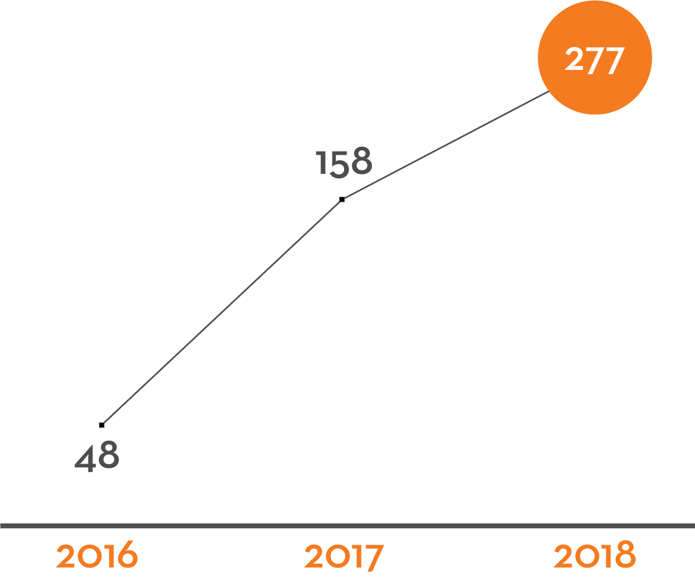
SPOTLIGHT ON THE PRESENT
CITY PARTNERSHIPS: WEST COVINA
IN 2018…
West Covina had 277 people experiencing homelessness in an alarming upward trend.
277
2018
Homeless Count

Slide 11
SPOTLIGHT ON THE PRESENT
NEW PARTNERSHIPS: WEST COVINA
IN 2018…
STAFF CO-LOCATED AT CITY HALL
BUILD RELATIONSHIPS WITH CITY DEPARTMENTS/POLICE/LOCAL BUSINESSES
OUTREACH (BUILDING TRUST WITH THOSE EXPERIENCING HOMELESSNESS)
FUNDING: LEVERAGED MEASURE H HOUSING NAVIGATION

Slide 12
LACK OF
POLITICAL WILL
SPOTLIGHT ON THE PRESENT
Lack of Or Misdirected Investment
WHAT DOESN’T WORK
LACK OF COORDINATION
Stand Alone Services
NIMBY-ism
Criminalization or Street Sweeping
COMMUNITY PUSH BACK / FEAR & LACK OF UNDERSTANDING
Bureaucracy
& Lack Of Flexibility
Focus On Emergency Needs Without Connections To Solutions
Outreach With No Pathway To Housing

Slide 13
SPOTLIGHT ON THE PRESENT
WHAT WORKS / OPPORTUNITIES
Employment
HOUSING
Targeted Engagement
Access Points
Continuum of Services
Health
= STABILITY
ENDING
HOMELESSNESS
Community Integration

Slide 14
SPOTLIGHT ON THE PRESENT
WHERE WE START
Partnerships & Collaborations
COUNTY SYSTEMS
COG/CONSORTIUM
PUBLIC & PRIVATE PARTNERSHIPS (USHS & COUNTY SERVICES / LAHSA)
FAITH GROUPS, BUSINESSES, EDUCATION, ETC.

Slide 15
SPOTLIGHT ON THE PRESENT
WHAT WILL MOVE US FORWARD
COMMUNITY ENGAGEMENT
- Reduce Fears
- Connect To People & Success Stories
ACCESS TO COMMUNITY DATA
EASIER ACCESS TO COUNTY RESOURCES
IMPLEMENTATION SUPPORT FOR CITIES
AND MOST IMPORTANTLY….
MORE HOUSING!

Slide 16
OUR VALUES
Organizational
Areas of Focus
RESPECT
ACCOUNTABILITY
COMMUNITY
RESILIENCE
EXCELLENCE
COURAGE
JUSTICE
“Excellence is not a skill. It is an attitude.” — Ralph Marston

Slide 17
Thank You!u!

