Slide 1
Electric Vehicle Infrastructure Needs
Minh Le, GM Energy and Environmental Services
County of Los Angeles, Internal Services Department

Slide 2
Macro Trends – Convergence of Renewable Electricity and Clean Transportation
1960-2010: CAISO load curve dominated by building load (HVAC) and population growth
2010-2040: CAISO net load curve greatly influenced by renewables
2025- : CAISO load curve greatly influenced by Transportation Electrification
California has over 20GW of solar installed
CAISO peak summer load of 46 GW
Solar now routinely represents of 50% of the mid-day generation
SB100
Transportation accounts for 41% of statewide GHG, 45% if refineries are included
Light duty BEV adoption increasing, now accounts for 3.3% of new car sales, PHEVs and BEVs now 6.2% combined and growing

Slide 3
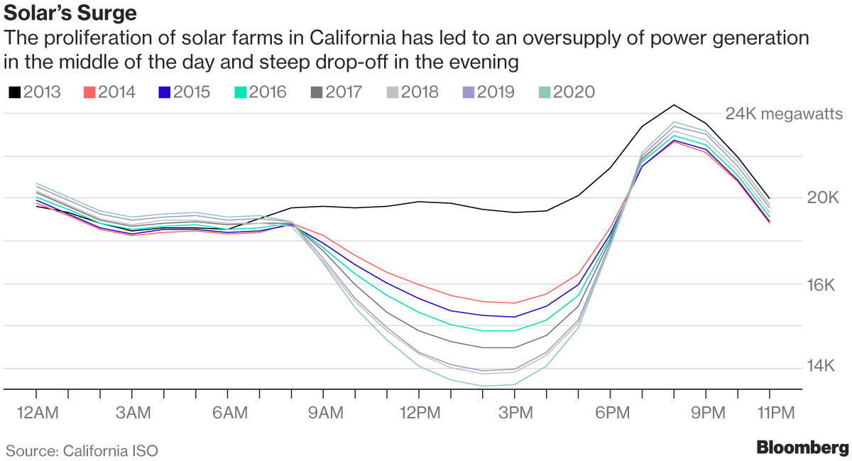
CAISO Duck Curve

Slide 4
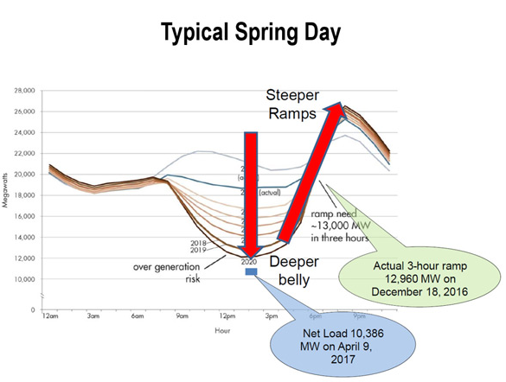
Belly of the Duck is getting deeper, head getting taller

Slide 5
Modeled Daily Load Profile from EVs in CA

Slide 6
Why does this all matter?

Slide 7
Transportation Electrification will be disruptive
Grid impact of EV charging will increase
Medium and Heavy duty will come on strong in the next decade and will have even greater grid challenges
Fleet electrification strategies will need to be developed to minimize costs
At the macro level, when and where charging occurs will have profound impacts on the grid, and therefore costs
We need to rethink “fueling”
The gas and diesel station network has been built over a century and benefit from network effects
EVSE network has only been developed over the past decade
While gas costs might vary slightly across a region, it generally costs the same throughout the day

